Slide 1
When Malignancy Breaks the 4th Wall: Skin manifestations of non-cutaneous cancers
Dr. Michael MacGillivary
FRCPC Dermatology

Slide 2
Disclosures
Dr. Michael MacGillivary
Honoraria and Advisory Boards for the following:
  Abbvie, Arcutis, Incyte, Janssen, Lilly, Organon, Pfizer, Sanofi, SunPharma, UCB

Slide 3
Mitigation of Potential Bias
Companies who have provided honoraria and where I’ve attended ad boards have not made any medications to treat the cutaneous components of these conditions and if treatments are discussed, conflicts will be identified.
These companies have not sponsored this talk.

Slide 4
Objectives
1) Recall five paraneoplastic dermatosis and their potential underpinnings
2) Distinguish when common skin diagnosis may indicate an internal malignancy
3) Select which skin manifestations of a paraneoplastic nature necessitate emergent dermatologic referral

Slide 5

Warm-Up Case
healthywoman.org

Slide 6
Warm-Up Case
Referral from Emerge…
  As discussed, please see this lovely 67YO gent with a very interesting skin eruption.
History on patient intake form:
  2 wk history of worsening ‘rash’
  +++ Pruritus
  No prior history of skin disease
  No travel, no new medications
  Weight loss over last year as unable to eat as much as before

Slide 7
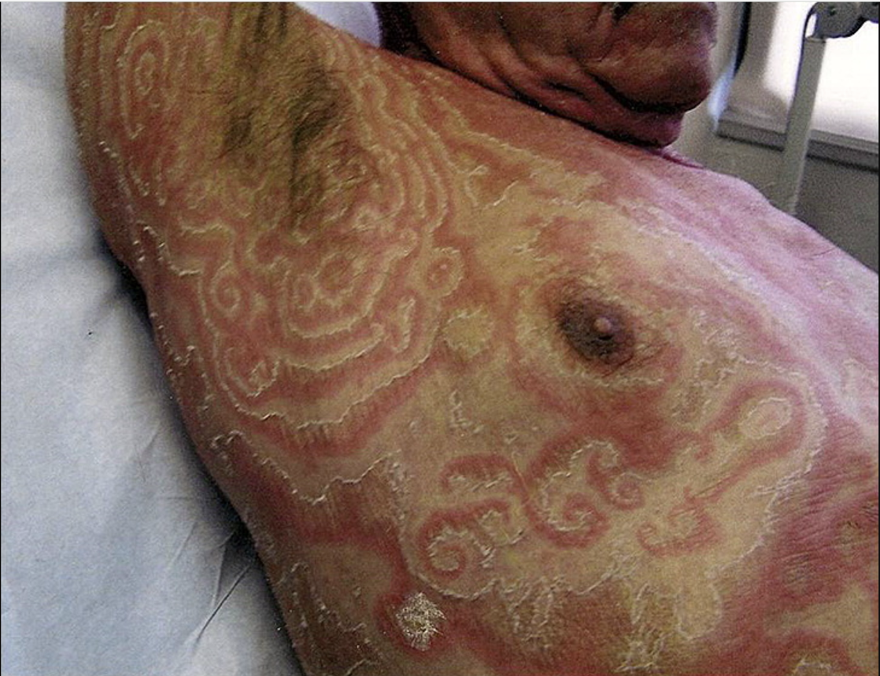
Warm-Up Case – Someone’s Being Knotty
JAAD, May 2011, 64:e89-e90

Slide 8
Warm-Up Case
Clinical DDx:
  …but first…

Slide 9

Warm-Up Case
ChatGPT

Slide 10
Warm-Up Case
Clinical DDx:
  Erythema gyratum repens, tinea imbricata
Work-up:
  Biopsy - Mild hyperkeratosis with focal parakeratosis and spongiosis, with perivascular lymphohistiocytic infiltrate with occasional eosinophils superficial dermis.
  Fungal scraping = N
  Labs – WBC = 12.1, RBC = 85, PLTS = N; Kidney function and liver enzymes and function = N.
  CT CAP – thickening of wall of gastric antrum
  Referral to GI, scope, gastric adenocarcinoma

Slide 11
Warm-Up Case –
Erythema gyratum repens
Commonly associated internal malignancies:
  Upper aerodigestive tract (pharynx, larynx or esophagus)
Pathophysiology:
  Deposition of tumor antigen-antibody complexes onto the basement membrane.
  Immunofluorescence patterns of IgG, C3, and C4 at the basement membrane
Treatment(s):
  Treat malignancy

Slide 12
Warm-Up Case –
Erythema gyratum repens
Can it be seen with other conditions?
  YES
    Tuberculosis
    Hypereosinophilic syndrome
    Bullous pemphigoid
    Pemphigus vulgaris
    Systemic lupus erythematosus
    Ulcerative colitis

Slide 13
Warm-Up Case –
Erythema gyratum repens
Is this a paraneoplastic dermatoses?

Slide 14
Curth’s Postulates (6)
1. Both conditions start simultaneously
2. Both conditions runs in parallel
3. The condition is not considered to be within a
genetic syndrome
4. A particular neoplasm is associated with a
particular dermatosis
5. The skin disorder is not common
6. There is a high percentage of association between the two conditions

Slide 15
Paraneoplastic Dermatoses - Categories
Association with neoplasm in most or all cases
  Bazex syndrome, Carcinoid syndrome, Erythema gyratum repens, Acquired hypertrichosis lanuginosa, Paraneoplastic pemphigus, AESOP syndrome, ACTH syndrome, Necrolytic migratory erythema, Tripe palms, Trousseau syndrome
Strong association with neoplasm in a subset of cases
  Acanthosis nigricans, Anti-laminin 332 mucous membrane pemphigoid, Dermatomyositis, Neutrophilic dermatoses

Slide 16
Paraneoplastic Dermatoses
Association with a monoclonal gammopathy
  Acquired angioedema due to C1 esterase inhibitor dysfunction, Cryoglobulinemia, type I, Normolipemic plane xanthoma, Necrobiotic xanthogranuloma, Amyloidosis, POEMS syndrome, Schnitzler syndrome, Scleromyxedema
PD that may be associated with cancer in a subset of patients
  CSSV, DH, Multicentric reticulohistiocytosis, Eruptive disseminated porokeratosis, JXGs in the setting of NF1, Acquired ichthyosis, Exfoliative erythroderma, Mycosis fungoides, PCT

Slide 17
Five Key Take-Away Points
Paraneoplastic dermatoses occur secondary to an underlying cancer, not due to direct tumour invasion or metastasis.
Curth’s postulates must be upheld for a dermatosis to be paraneoplastic
Paraneoplastic dermatoses can appear months to years before the malignancy is detected, making recognition clinically important
Paraneoplastic dermatoses most often correlate with lymphomas, leukemias, GI cancers (especially gastric), lung cancer, and gynecologic malignancies.
Paraneoplastic dermatoses often resolve or significantly improve when the underlying tumour is treated and may recur with relapse.

Slide 18
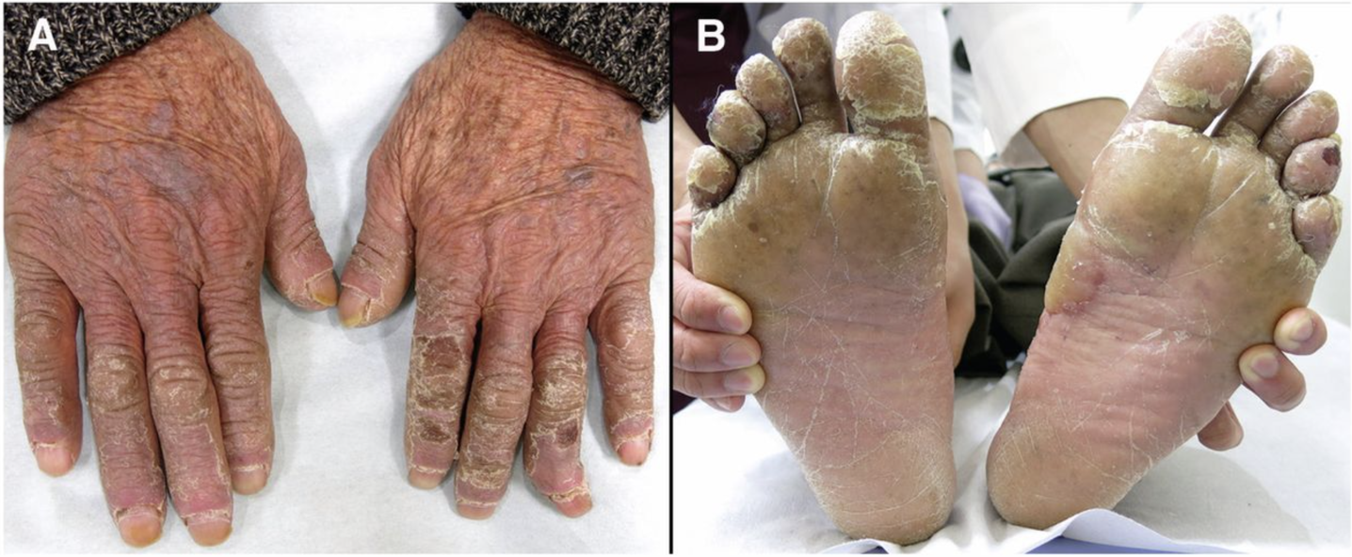
Case #2 – Scaly Hands and Feet
CMAJ May 01, 2017 189 (17) E639

Slide 19
Case #2 – Bazex Syndrome (Acrokeratosis paraneoplastica)
Clinical DDx:
  Psoriasis, eczema, tinea pedis/manuum
Distinguishing features:
  Violaceous hue
  Involvement of nose and ears
  Longitudinal and horizontal ridging of nails
Commonly associated internal malignancies:
  Upper aerodigestive tract (pharynx, larynx or esophagus)

Slide 20
Case #2 – Bazex Syndrome (Acrokeratosis paraneoplastica)
Pathophysiology:
  Immunological Cross-Reactivity: Tumor-associated antigens mistakenly targets skin cells, causing psoriasiform lesions.
  Immune System Shift: Underlying malignancy may cause shift toward a Th2 immune pathway, which can lead to increased expression of epidermal growth factor receptors in keratinocytes, causing skin changes.
  Tumors might produce growth factors that stimulate excessive proliferation of skin cells.
  Tumor-Related Deficiencies: Nutritional or zinc deficiencies resulting from the tumor's expansion may contribute to the hyperkeratosis.
Treatment(s):
  Topical corticosteroids, keratolytics and oral retinoids
  Treat malignancy

Slide 21
Case #2 – Bazex Syndrome (Acrokeratosis paraneoplastica)
Can it be seen with other conditions?
  NO.

Slide 22
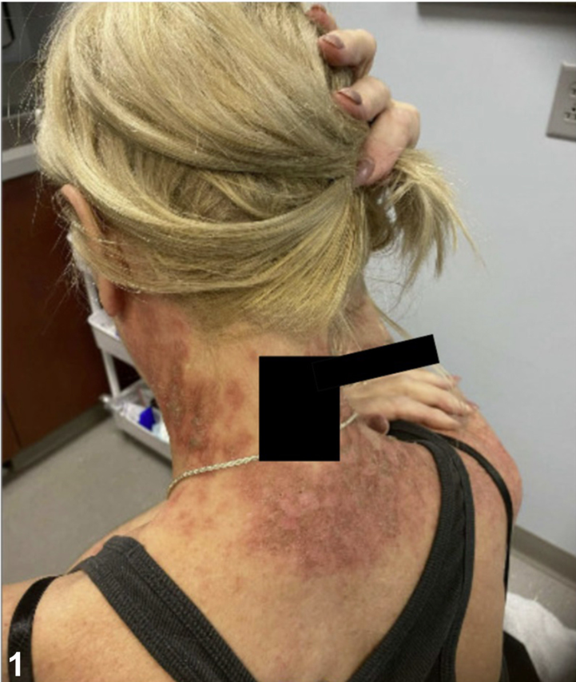
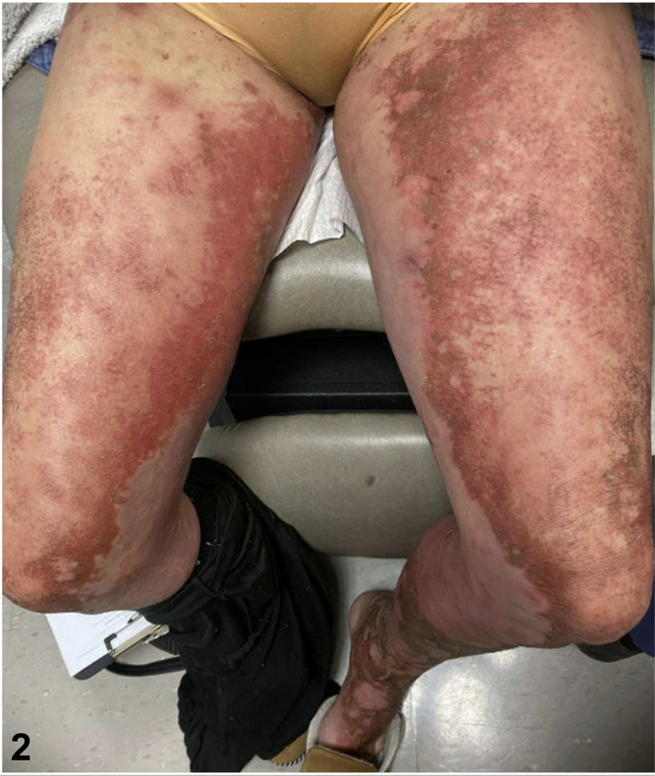
Case #3 – Migrating ‘sloughing’ lesions
JAAD Case Reports
Volume 63, September 2025, Pages 154-157

Slide 23
Case #3 –
Necrolytic migratory erythema
Clinical DDx:
  Acrodermatitis enteropathica (Zinc deficiency), essential fatty acid deficiency, Pellagra (niacin deficiency), severe candidiasis, pemphigus foliaceus, bacterial infections, drug eruption
Distinguishing features:
  Occurs with angular cheilitis, glossitis
  Extremely erythematous, superficial epidermal necrosis and spreads centrifugally
Commonly associated internal malignancies:
  Glucagonoma, an alpha-cell tumor of the pancreatic islets

Slide 24
Case #3 –
Necrolytic migratory erythema
Pathophysiology:
  Catabolic state induced by excess serum glucagon results in the derangement of a common metabolic pathway involving zinc, protein, amino acids, and essential fatty acids.
Treatment(s):
  Zinc supplementation
  Treat malignancy

Slide 25
Case #3 –
Necrolytic migratory erythema
Can it be seen with other conditions?
  YES
    Celiac disease
    Inflammatory bowel disease
    Pancreatic insufficiency

Slide 26
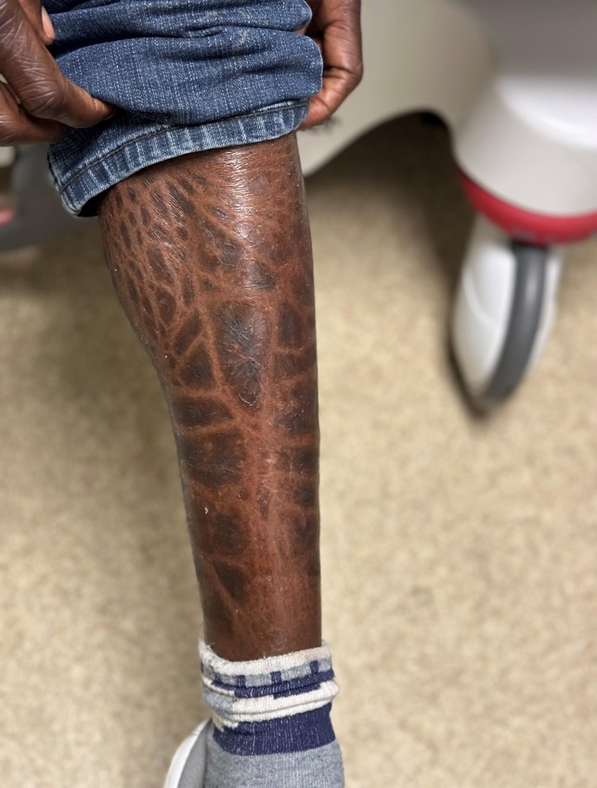
Case #4 – Tale of the Scale

Slide 27
Case #4 – Ichthyosis
Clinical DDx:
  Asteototic eczema
Distinguishing features:
  Scaling is more plate-like
  Responds less to emollients
Commonly associated internal malignancies:
  Hodgkin’s lymphoma

Slide 28
Case #4 – Ichthyosis
Pathophysiology:
  Malignant Reed-Sternberg cells in HL produce transforming growth factor-alpha. High levels of TGF-alpha can cause hyper-proliferation of keratinocytes, resulting in a thickened, flaky epidermis.
Treatment(s):
  Moisturizers and emollients
  Topical keratolytics
  Topical and oral retinoids
  Treat malignancy

Slide 29
Case #4 – Ichthyosis
Can it be seen with other conditions?
  YES (Plenty)
    Primary (Ichthyosis vulgaris)
    Secondary/Acquired
      Endocrine and metabolic disorders
        Hypothyroidism
      Infections
        HIV, Leprosy
      Autoimmune/inflammatory conditions
        Lupus erythematosus (SLE), dermatomyositis, and sarcoidosis
      Nutritional and malabsorption conditions
        Celiac disease, Crohn's disease, or pancreatic insufficiency
      Medications
        Statins, nicotinic acid, allopurinol
      Graft versus host disease

Slide 30
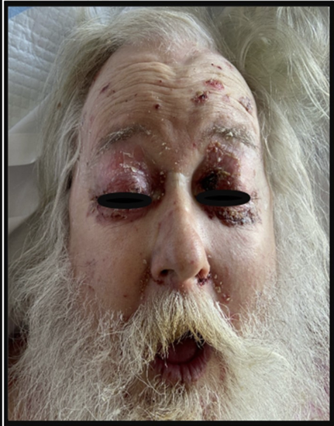
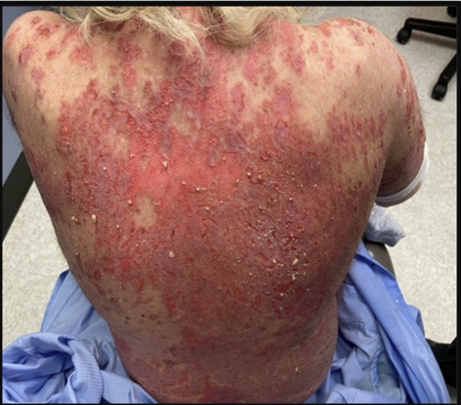
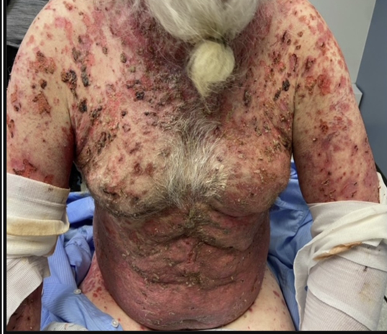
Case #5 – Blisters and peeling and oral lesions, ohhhh my!
JAAD Case Reports
Volume 35, May 2023, Pages 103-107

Slide 31
Case #5 – Paraneoplastic pemphigus
Clinical DDx:
  Pemphigus vulgaris, EM, SJS/TEN, BP, Lichen planus pemphigoides, GVDH, MMP
Distinguishing features:
  Refractory stomatitis
  Palmoplantar involvement
  Polymorphous lesions
  Pulmonary involvement (bronchiolitis obliterans; Paraneoplastic AI Multiorgan Syndrome
Commonly associated internal malignancies:
  Non-Hodgkin lymphoma, Chronic lymphocytic leukemia, Castleman disease
  Sarcomas, thymomas, SCC of skin, carcinoma lung, colon
EMERGENT
CONDITION

Slide 32
Case #5 – Paraneoplastic pemphigus
Pathophysiology:
  Autoantibodies, targeting antigens on cancer cells, including Dsg1, Dsg3, Desmoplakin 1, Envoplakin, Epiplakin, Periplakin leading to acantholysis and extensive interface dermatitis
Treatment(s):
  Treat malignancy
  High dose systemic corticosteroids
  Rituximab, azathioprine, cyclosporine, MMF, IVIG
  Case reports: alemtuzumab (anti-CD52)

Slide 33
Case #5 – Paraneoplastic pemphigus
Can it be seen with other conditions?
  No

Slide 34
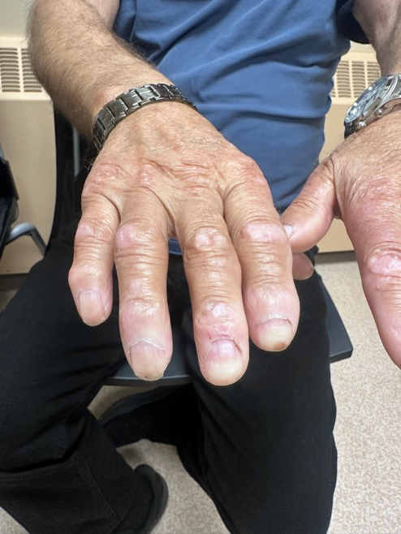
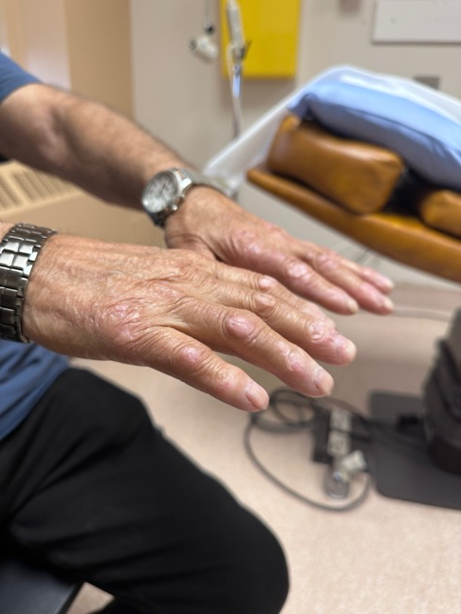
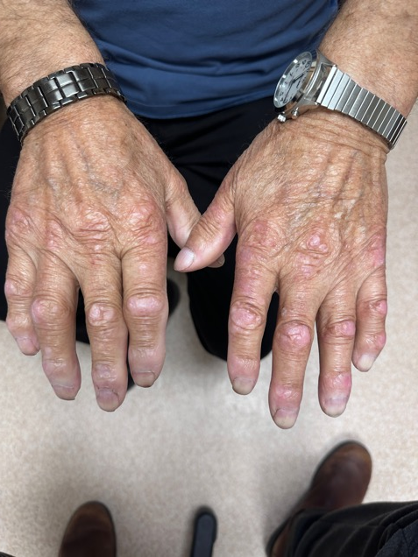
Case #6 – A cowboy with a shawl

Slide 35
Case #6 – Dermatomyositis
Clinical DDx:
  Scleroderma, RA, MCTD
Distinguishing features:
  Cutaneous signs on hands
  Holster and shawl sign
  Heliotrope eruption
Commonly associated internal malignancies:
  Anti-TIF-1 gamma and NXP2 (+) ive
  COLON (COlorectal, Lung, OvariaN), breast, pancreatic

Slide 36
Case #6 – Dermatomyositis
Pathophysiology:
  Antibodies against tumor antigens target antigens in skin and muscle tissue
  Immune complex deposition
    Complement system
      Destruction of endothelial cells in capillaries
Treatment(s):
  Treat malignancy
  Systemic corticosteroids (~1mg/kg/day)
  MTX, Azathioprine, MMF, IVIG
  Emerging: ACTH gel injection, Brepocitinib (JAK/TYK2 inhibitor) and BLyS/BAFF inhibition

Slide 37
Case #6 – Dermatomyositis
Can it be seen with other conditions?
  Yes
    Infections
      Coxsackie B virus, enterovirus, parvovirus B19 and HIV
    Drug-Induced
      Statins
      Penicillin, sulfonamides, isoniazid
      Hydroxyurea, cyclophosphamide
      NSAIDs
    High-intensity UV radiation exposure
    Silica exposure

Slide 38
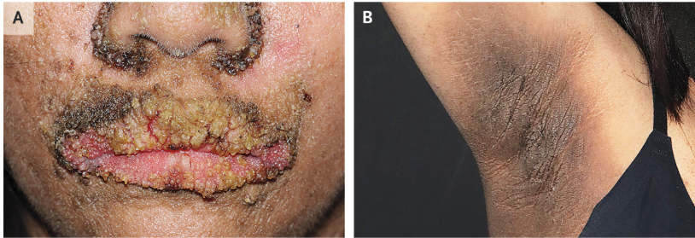
Case #7 –
Ensconced in Velvety Plaques
NEJM
Volume 388, March 2023, 1031

Slide 39
Case #7 – Acanthosis nigricans
COMMON
CONDITION
Clinical DDx:
  CARP, seb derm, erythrasma
Distinguishing features:
  Atypical location for AN and ++ rapid development
  Non-obese individuals
Commonly associated internal malignancies:
  Gastric adenocarcinoma – most common
  ++ others (pancreatic, hepatic, esophageal, genitourinary, breast, lung, lymphoma and sarcomas

Slide 40
Case #7 – Acanthosis nigricans
Pathophysiology:
  Tumor secretes TGF-alpha and IGF-1 which bind to EGFR and IGFR receptors in the skin, causing thickening and hyperpigmentation
Treatment(s):
  Treat malignancy
  Topicals (retinoids, keratolytics, Vit. D analogs)
  Laser
  Dermabrasion

Slide 41
Case #7 – Acanthosis nigricans
Can it be seen with other conditions?
  Yes
    Endocrine
      Insulin resistance, PCOS, Cushing’s syndrome, Addison’s disease, Hypothyroidism
    Medications
      Niacin, OCP, Corticosteroids, Growth Hormone Tx, Protease Inhib
    Genodermatoses
      Familial acanthosis nigricans (FGFR3 gene)
      Beare-Stevenson cutis gyrate syndrome (FGFR2 gene)

Slide 42
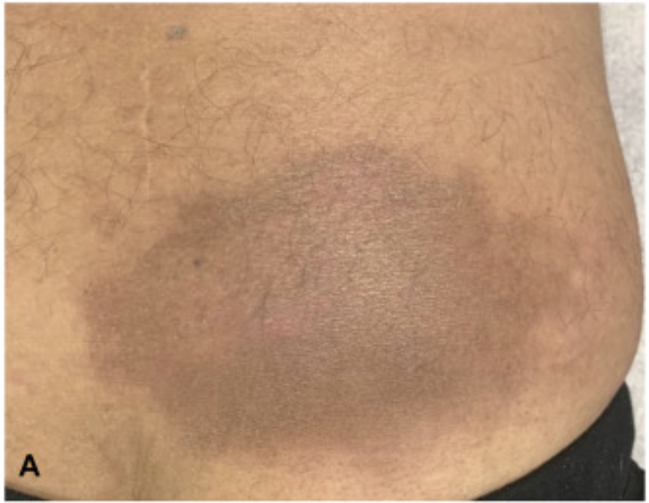
Case #8 – This is No Fable
JAAD Case Reports
Volume 63, September 2025, Pages 162-4

Slide 43
Case #8 – AESOP Syndrome
Adenopathy and Extensive Skin patch Overlying a Plasmacytoma
Clinical DDx:
  Lichen amyloidosis, angiosarcoma, erythema migrans, inflammatory morphea
Distinguishing features:
  Usually overlies bony prominence
  Dilated telangectasias
  Associated regional lymphadenopathy
Commonly associated internal malignancies:
  Plasmacytoma
  Often early signs of POEMS Syndrome (polyneuropathy, organomegaly, endocrinopathy, M-protein, and skin changes)

Slide 44
Case #8 – AESOP Syndrome
Adenopathy and Extensive Skin patch Overlying a Plasmacytoma
Pathophysiology:
  The underlying clonal plasma cells, usually producing
  gamma light chains, secrete high levels of pro-inflammatory and angiogenic growth factors causing skin changes.
Treatment(s):
  Treat malignancy

Slide 45
Case #8 – AESOP Syndrome
Adenopathy and Extensive Skin patch Overlying a Plasmacytoma
Can it be seen with other conditions?
  NO

Slide 46
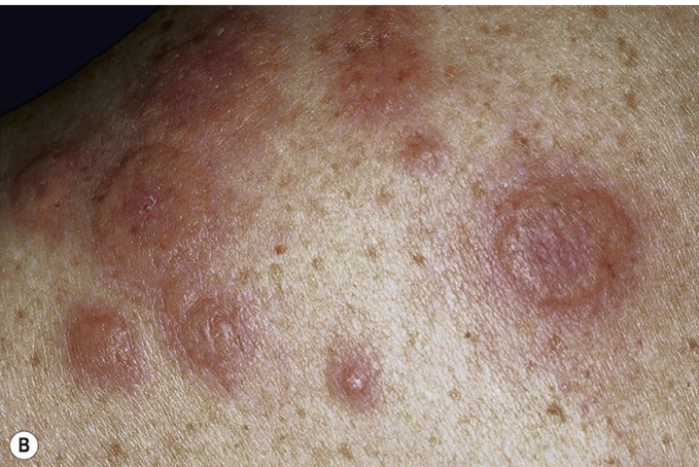
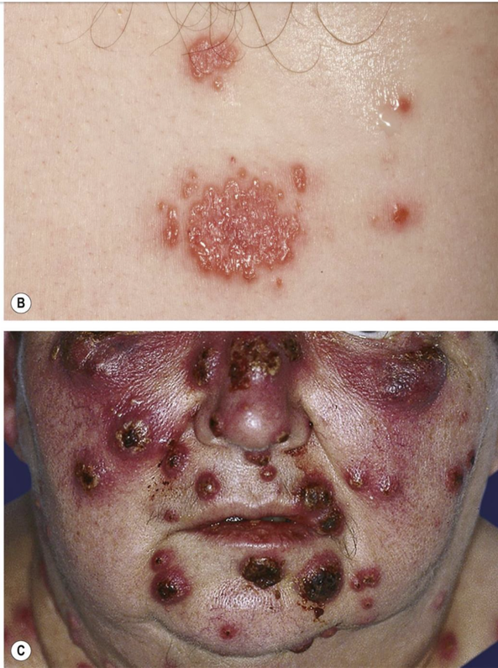
Case #9 – Time for Dessert
Dermatology, Bologna, 5th Ed. Pg. 453

Slide 47
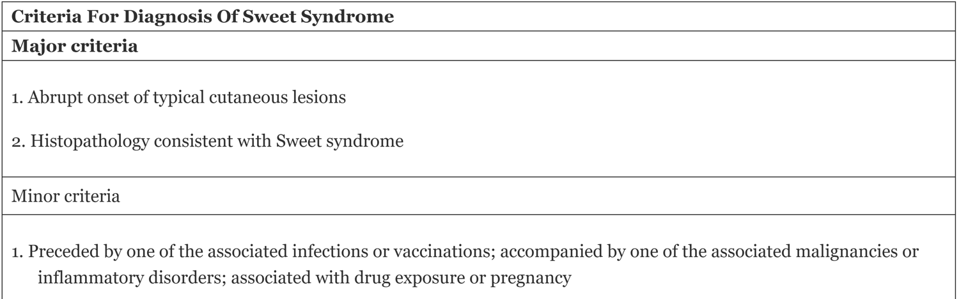
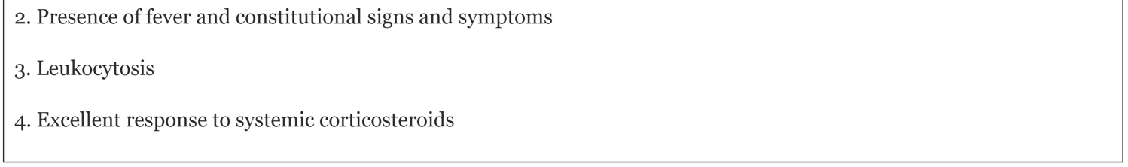
Case #9 – Neutrophilic dermatoses –
Acute Febrile Neutrophilic Dermatosis
Dermatology, Bologna, 5th Ed. Pg. 456

Slide 48
Case #9 – Neutrophilic dermatoses –
Acute Febrile Neutrophilic Dermatosis
Clinical DDx (in brief):
  Cellulitis, Erythema multiforme, Arthropod bites
Distinguishing features:
  Tender, non-pruritic papules coalescing into plaques
  Pseudo-vesicular, mammilated
  More widespread than other causes
Commonly associated internal malignancies:
  Acute myelogenous leukemia
  Myelodysplasia (including VEXAS syndrome)

Slide 49
Case #9 – Neutrophilic dermatoses –
Acute Febrile Neutrophilic Dermatosis
Pathophysiology:
  Neutrophils in the cutaneous infiltrate and the malignant myeloid clone appear to share a clonal progenitor
Treatment(s):
  Find underlying cause (treat malignancy)
    Infection, Meds, AI,
  Prednisone (1mg/kg/day)
  Potassium iodide, colchicine, dapsone

Slide 50
Case #9 – Neutrophilic dermatoses
Acute Febrile Neutrophilic Dermatosis
Can it be seen with other conditions?
  YES (Plenty)
    Infections
      Upper respiratory tract infections
      Bacteria (Yersinia, strep), Mycobacteria, Fungi
    GI disorders
      IBD
    Medications
      Colony stimulating factors
      Retinoids
      Azathioprine
      Antibiotics (minocycline, TMP/SMX, quinolones)
      TNF-alpha inhibitors

Slide 51
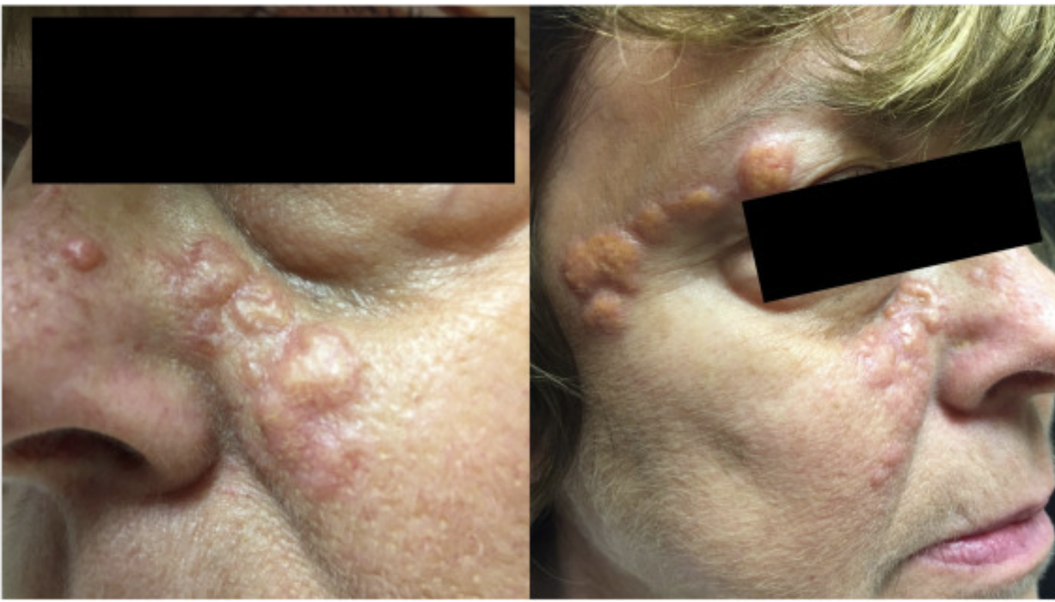
Case #10 –
Rapid onset yellow nodules
JAAD Case Reports
Volume 32, February 2023, 41-3

Slide 52
Case #10 –
Necrobiotic xanthogranuloma
Clinical DDx:
  Xanthelasma, sarcoidosis, the facial Ls
Distinguishing features:
  Yellow to red-brown papulonodules with atrophy and telangectasias
  Periorbital distribution is classic
  High rates of ulceration
Commonly associated internal malignancies:
  Monoclonal gammopathy (IgG-kappa and IgG-lambda), multiple myeloma, chronic lymphocytic leukemia/small lymphocytic leukemia

Slide 53
Case #10 –
Necrobiotic xanthogranuloma
Pathophysiology:
  Monoclonal paraproteins form complexes with lipoproteins, deposition in the dermis, phagocytized by macrophages triggering a granulomatous reaction
Treatment(s):
  Treat malignancy
  Systemic and intralesional corticosteroids
  IVIG
  JAK inhibitors
  Hydroxychloroquine and dapsone

Slide 54
Case #10 –
Necrobiotic xanthogranuloma
Can it be seen with other conditions?
  No

Slide 55
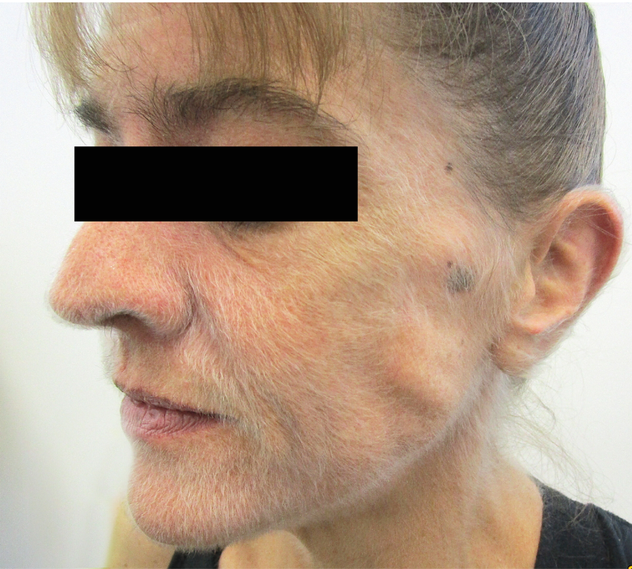
Case #11 –
Things Might Get a Bit Hairy
NEJM
Volume 383, December 2020, e144

Slide 56
Case #11 –
Acquired hypertrichosis lanuginosa
Clinical DDx:
  N/A
Distinguishing features:
  Fine, lanugo hair developing in areas where vellus hair usually occurs
Commonly associated internal malignancies:
  Colorectal, lung, breast and uterine cancer

Slide 57
Case #11 –
Acquired hypertrichosis lanuginosa
Pathophysiology:
  Tumor produces EGF and TGF-alpha
    Stimulates hair follicles to revert to a follicular, fetal-like growth state, producing lanugo hair
  Can accompany other paraneoplastic dermatoses
    Icthyosis, acanthosis nigricans and tripe palms (stay tuned)
Treatment(s):
  Treat underlying malignancy
  Laser
  Shaving
  Chemical depilation

Slide 58
Case #11 –
Acquired hypertrichosis lanuginosa
Can it be seen with other conditions?
  Yes
    Severe malnutrition (anorexia nervosa)
    Hyperthyoridism
    HIV/AIDS
    Medications
      Cyclosporin
      Phenytoin
      Interferon
      Corticosteroids

Slide 59
Curth’s Postulates (6) - Review
1. Both conditions start simultaneously
2. Both conditions runs in parallel
3. The condition is not considered to be within a
genetic syndrome
4. A particular neoplasm is associated with a
particular dermatosis
5. The skin disorder is not common
6. There is a high percentage of association between the two conditions

Slide 60
Five Key Take-Away Points
Paraneoplastic dermatoses occur secondary to an underlying cancer, not due to direct tumour invasion or metastasis.
Curth’s postulates must be upheld for a dermatosis to be paraneoplastic
Paraneoplastic dermatoses can appear months to years before the malignancy is detected, making recognition clinically important
Paraneoplastic dermatoses most often correlate with lymphomas, leukemias, GI cancers (especially gastric), lung cancer, and gynecologic malignancies.
Paraneoplastic dermatoses often resolve or significantly improve when the underlying tumour is treated and may recur with relapse.

Slide 61
Recap Objectives
1) Recall five paraneoplastic dermatosis and their potential underpinnings
2) Distinguish when common skin diagnosis may indicate an internal malignancy
3) Select which skin manifestations of a paraneoplastic nature necessitate emergent dermatologic referral

Slide 62

Questions?
shutterstock.com

