Slide 1
Chronic Spontaneous Urticaria:
A Brief Overview
Dr. Jacqueline Mouris, md frcpc
Allergy & Clinical Immunology
April 24, 206

Slide 2

Disclosure
Dr. Jacqueline Mouris
Relationship with financial sponsors
  Direct financial relationship, including honoraria: N/A
  Membership on Advisory boards or Speakers’ bureaus:
    Celltrion – Advisory Board for Omlyclo (omalizumab)
  Patent for drugs or devices: N/A
  Other financial relationships or investments: N/A
No active research

Slide 3
Mitigation of Potential Bias
Not applicable (none exist)

Slide 4
Objectives
Define Chronic Spontaneous Urticaria (CSU) and describe its key clinical features.
Identify the diagnostic criteria and recommended evaluation approach for CSU, including differentiation from other types of urticaria and related conditions.
Discuss current evidence-based management strategies for CSU, including stepwise pharmacologic treatment and emerging therapies.
Evaluate the impact of CSU on patient quality of life and outline strategies for long-term monitoring, patient education, and multidisciplinary care.

Slide 5

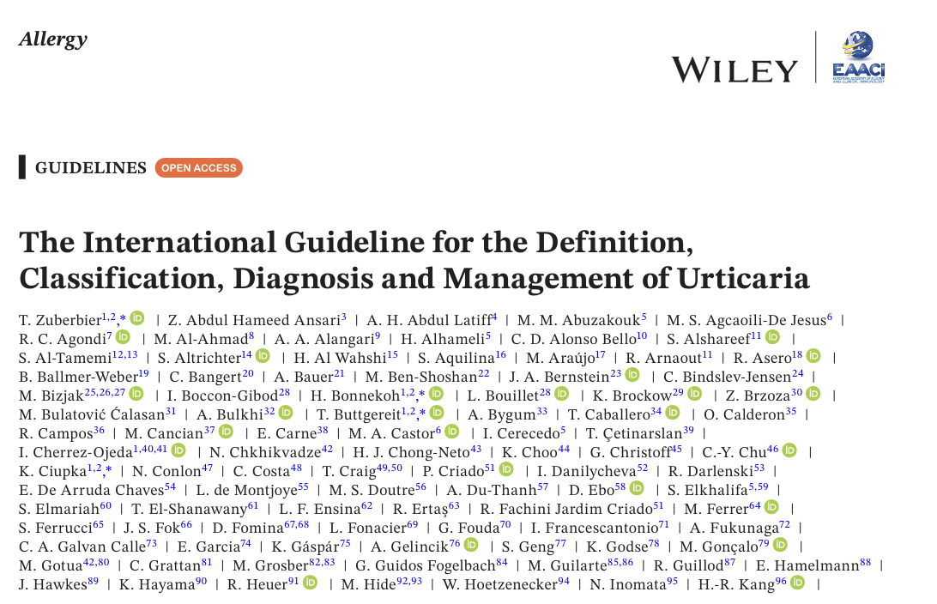

Newest Guidelines
2026

Slide 6

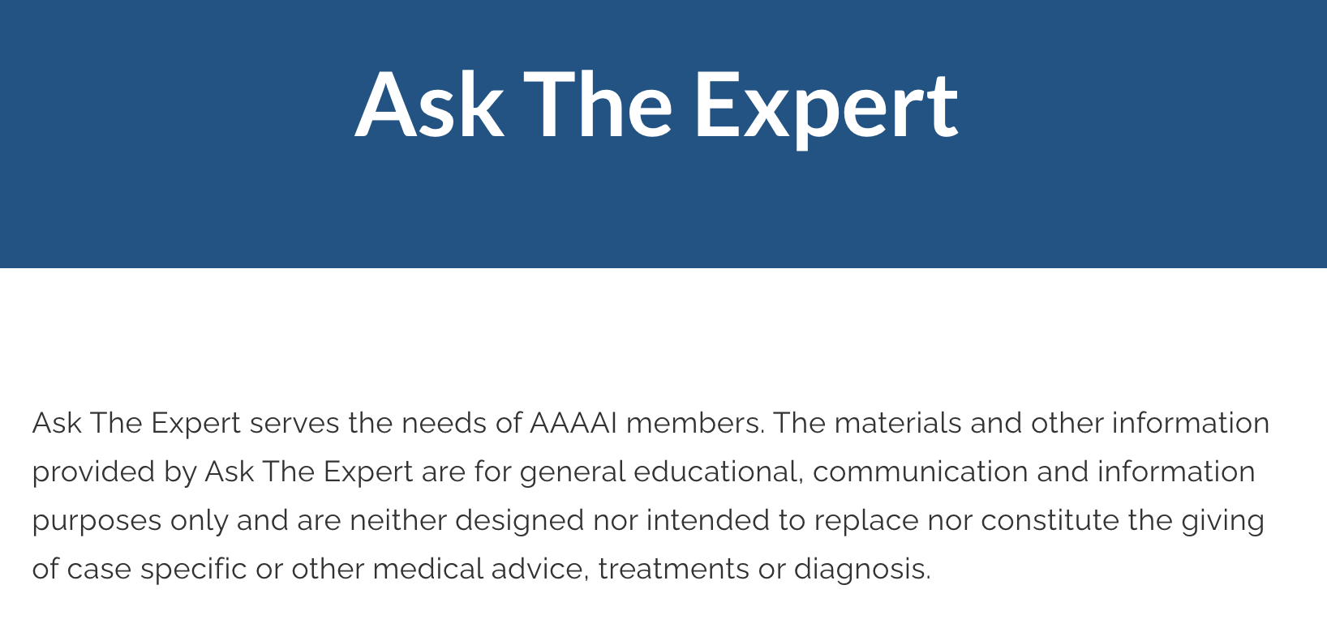

Main Guidelines for Canada
EAACI
AAAAI
CSACI (no specific guideline)
AAAAI – Ask The Expert – great resource
(no login required)

Slide 7
Urticaria
“Characterized by the development of wheals (hives), angioedema, or both.”
(EAACI 2026)
Must rule out:
Anaphylaxis
autoinflammatory syndromes
urticarial vasculitis
bradykinin- mediated angioedema
hereditary angioedema (HAE)
ACEi AE (no hives)

Slide 8
Urticaria
Cutaneous mast cell degranulation leading to….
Release of vasoactive mediators → Histamine + Cytokines + Plt Activating Factor (PAF)
Causes sensory nerve involvement, triggers vasodilation & increases vascular permeability
= Urticaria / Angioedema

Slide 9
Urticaria
Raised
Erythematous
Clearly defined
…can coalesce
Burn / Itch / Hot
Must be careful in people of colour because can have similar hue to surrounding skin

Slide 10
Urticaria
  Dermographism
  Cold urticaria
  Cholinergic urticaria (heat) --- exercise, fever, sweat, sauna, hot tub, stress, food
  Contact urticaria
  Delayed pressure urticaria
  Solar urticaria
  Heat urticaria
  Vibratory urticaria
  Aquagenic urticaria
Acute v Chronic (6 weeks)
Idiopathic “ASU / CSU”
Inducible

Slide 11
My approach
History. Then…MORE HISTORY.
  Timing. Location. Frequency. Time to recovery.
Photos
  If none, ask for some at follow up
Angioedema?
Sickness? Stress?
  VIRAL wildly common trigger.
Meds? NSAIDs?
Dentist? ACEi? Chemo? Rads?
Resp? GI? N/V/D?
Treatment – response? Epi?
Labs to rule out *other*

Slide 12
Treatment
H1, H2, LTRA, Biologics, Other

Slide 13
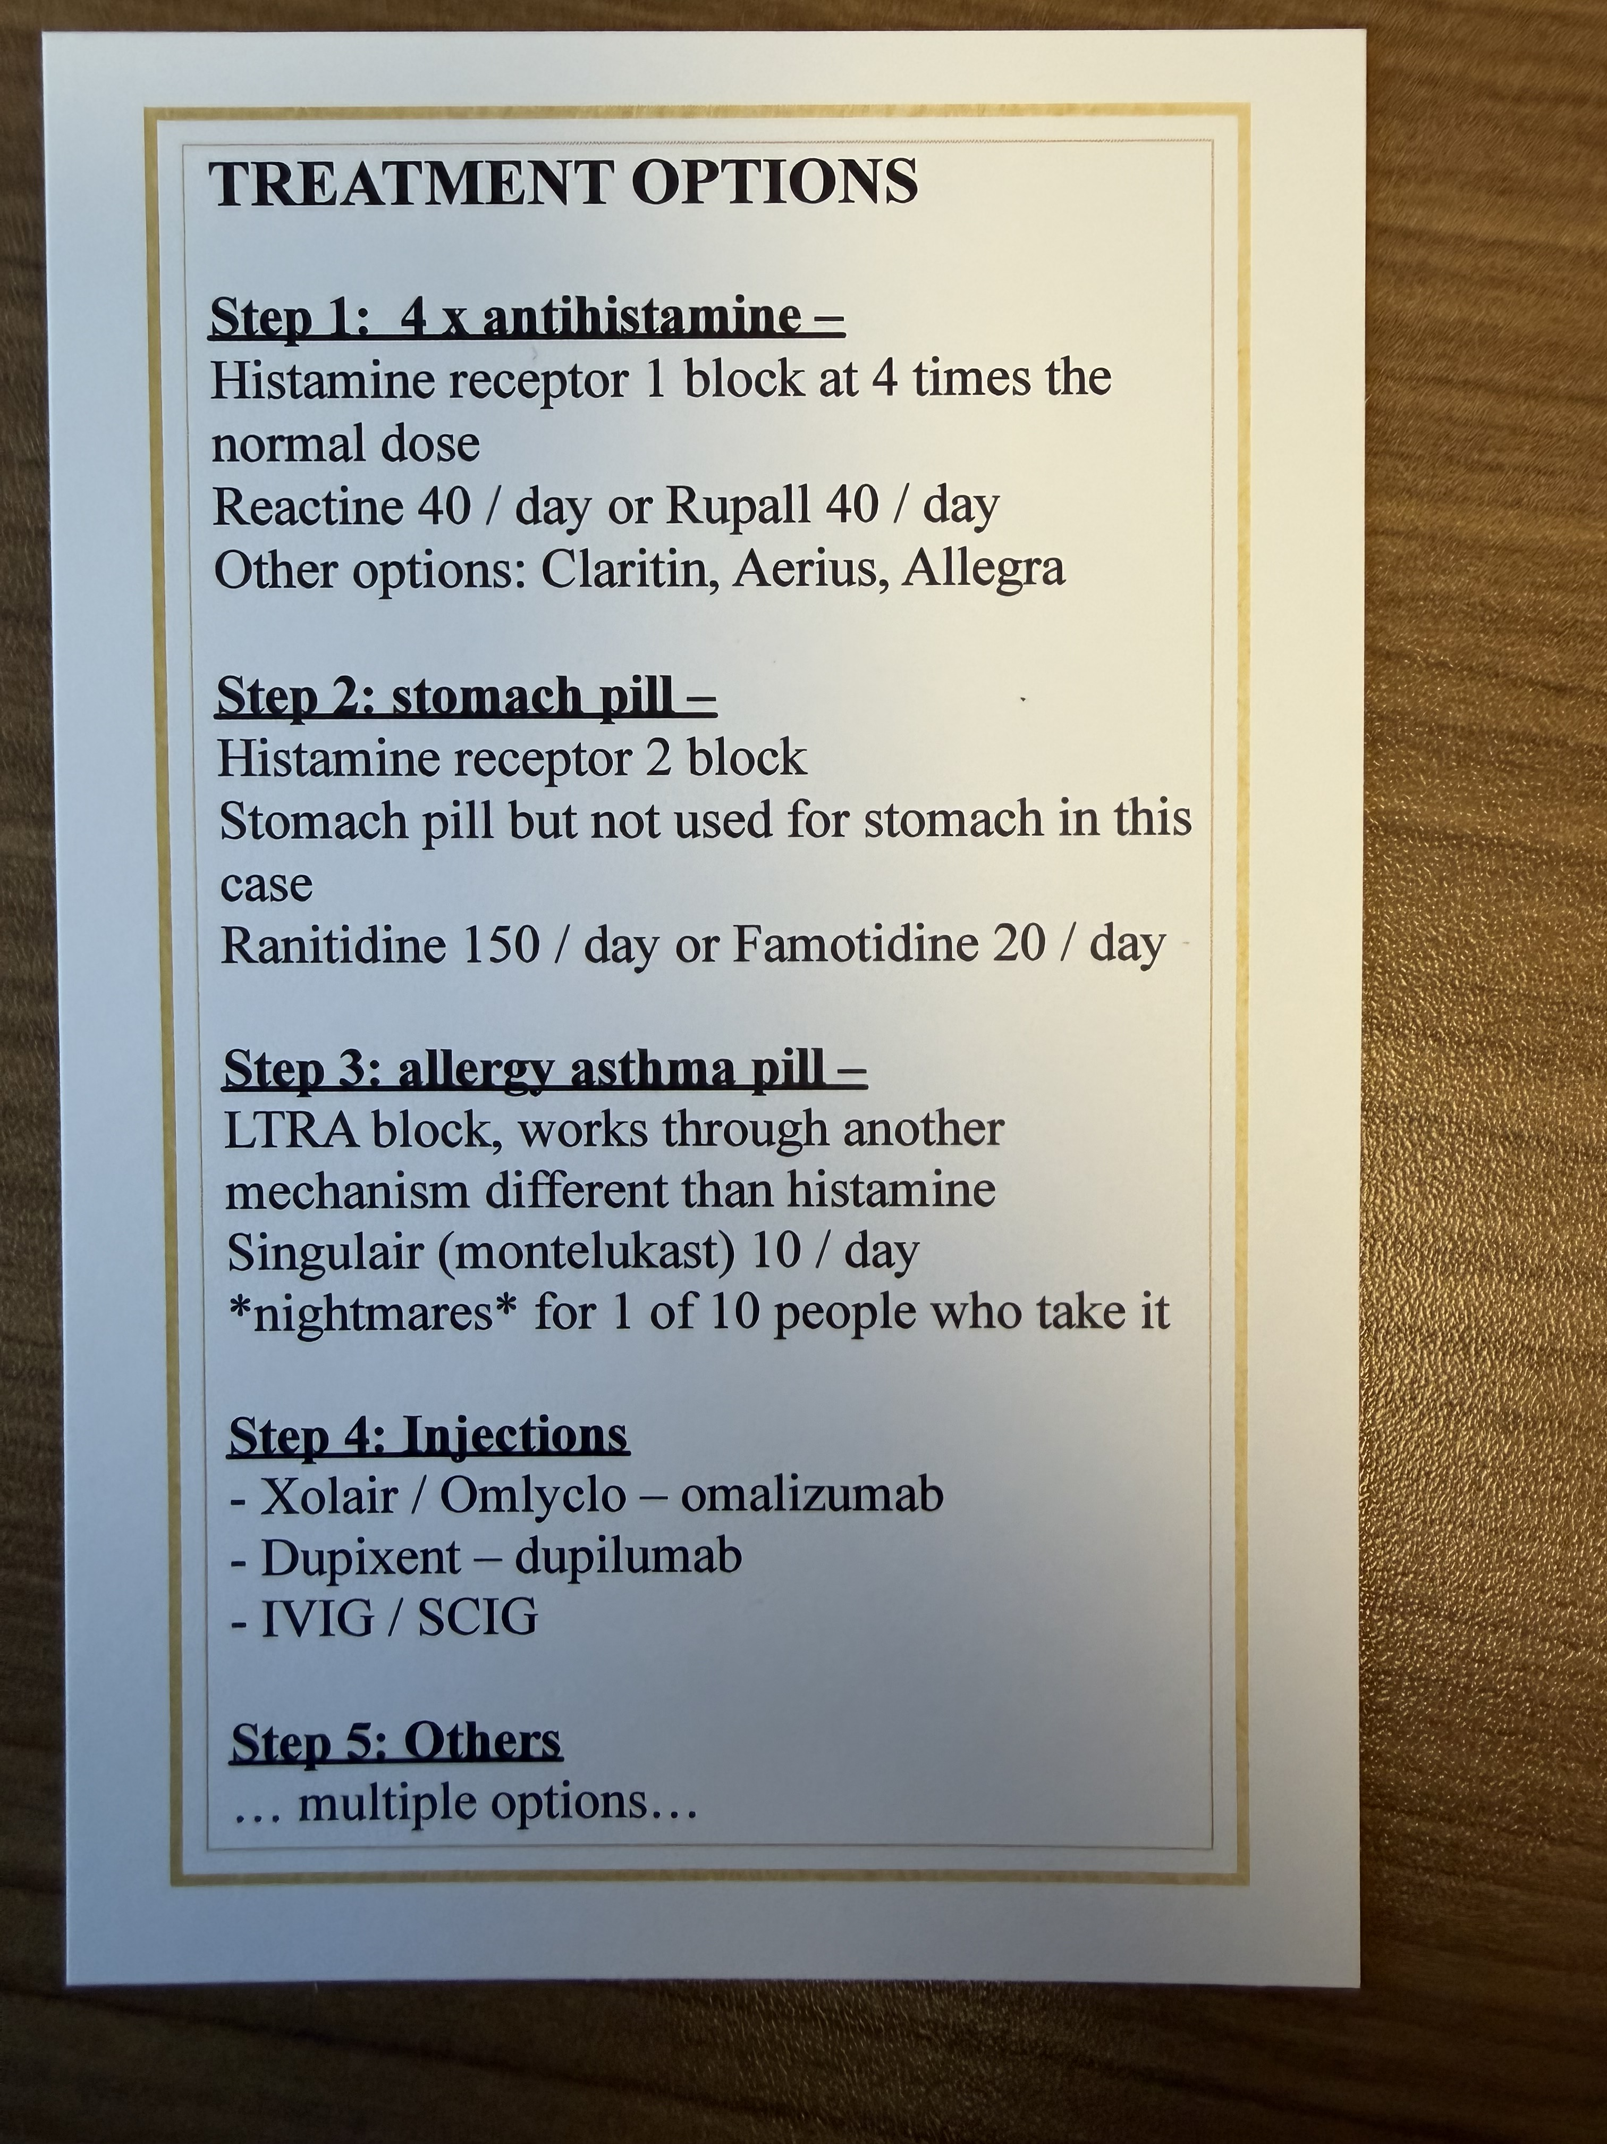
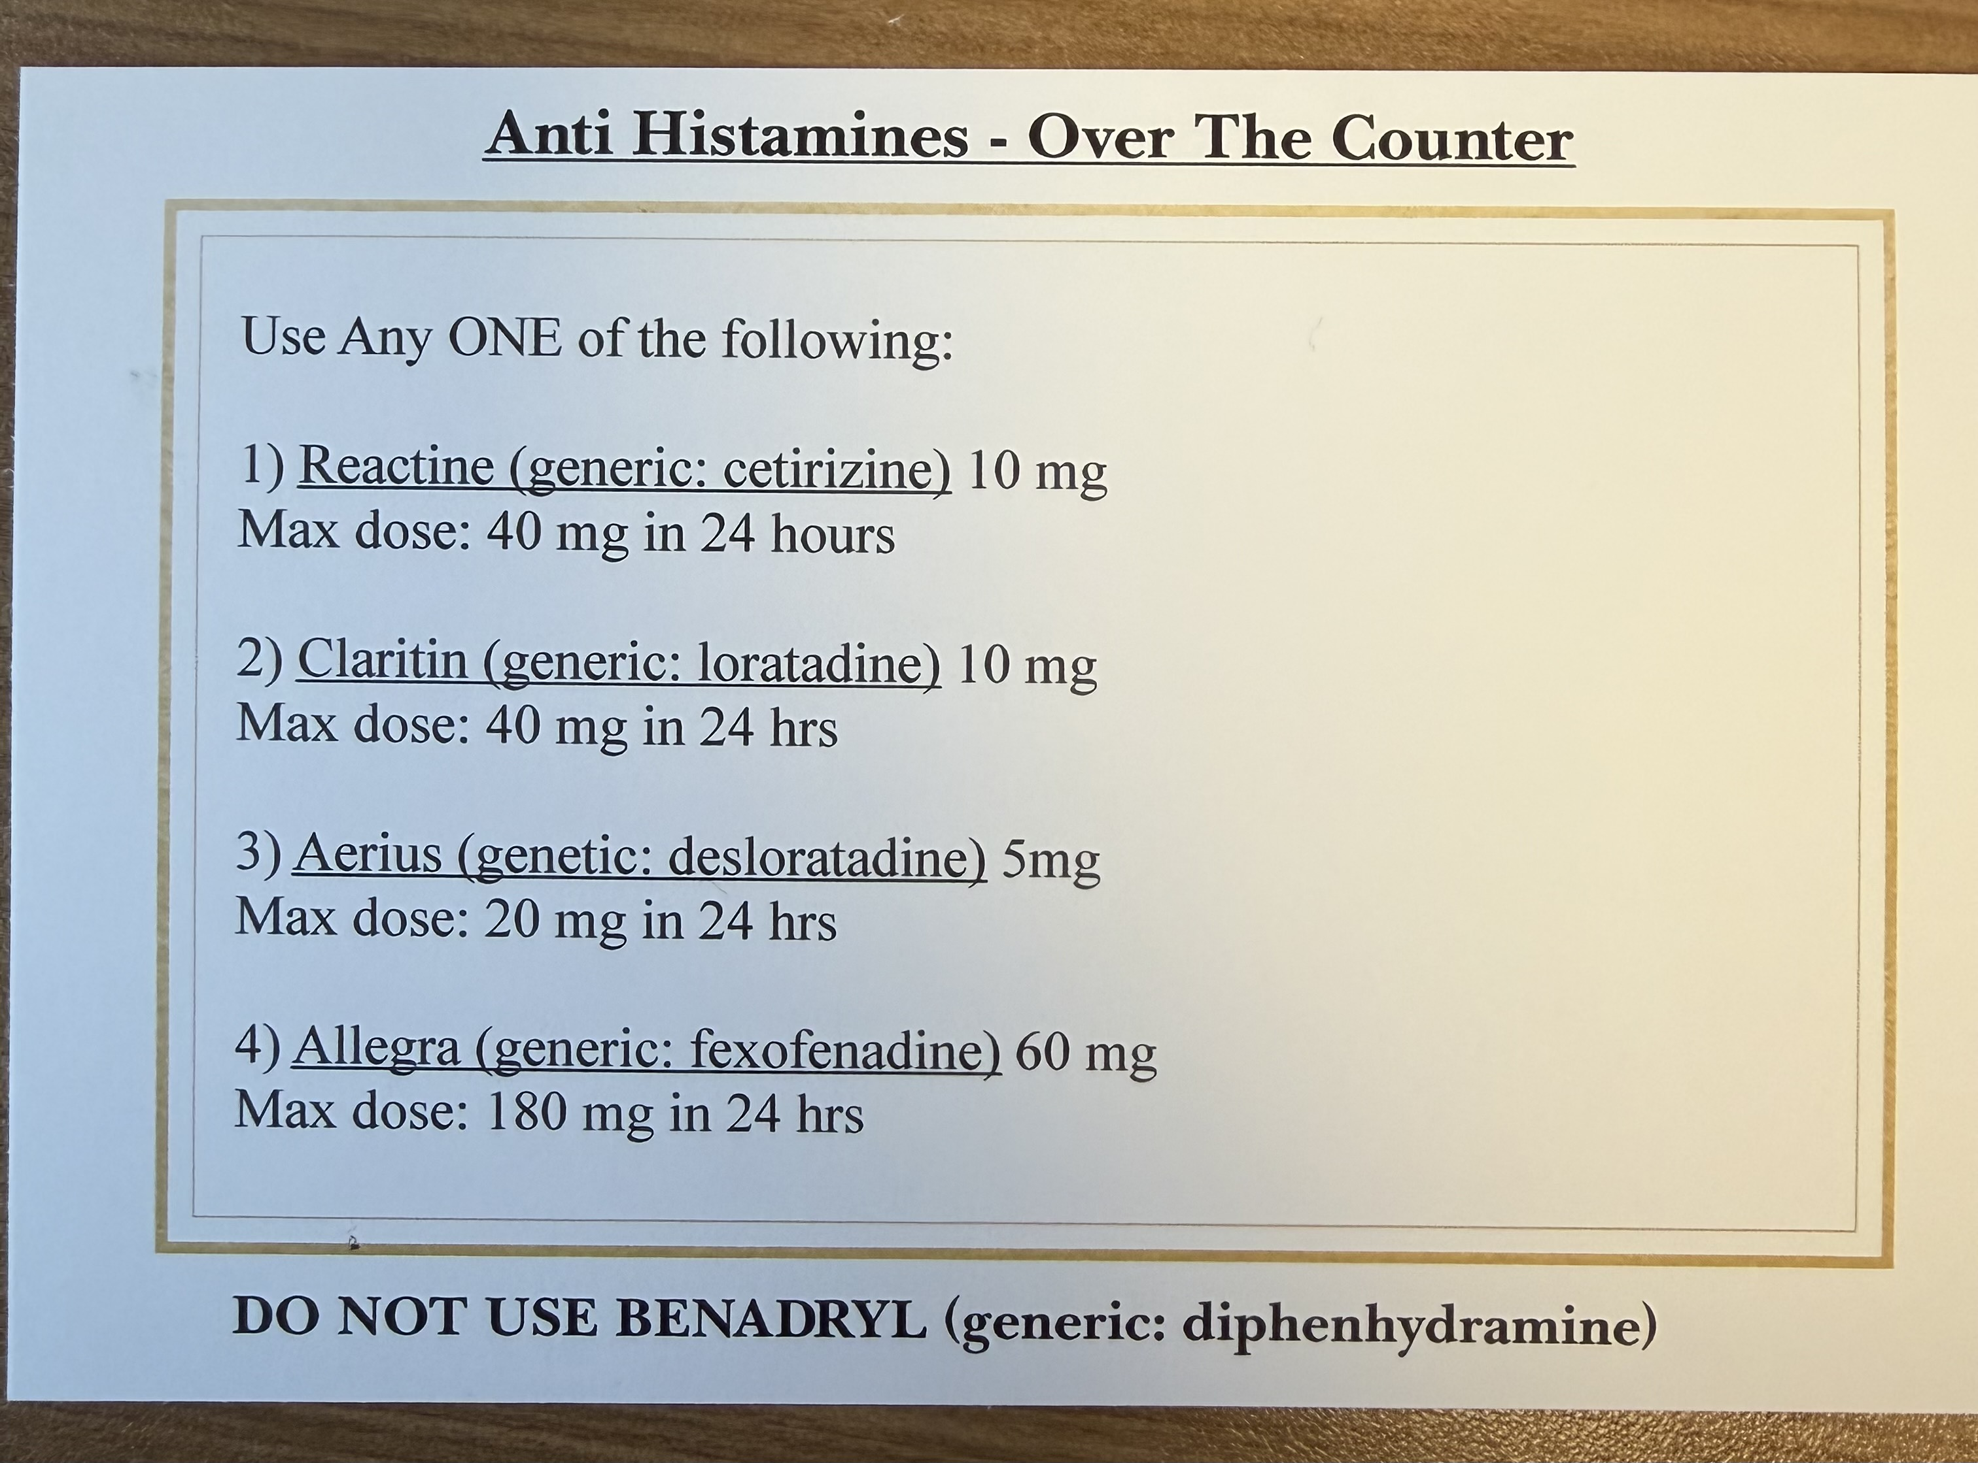

Slide 14
Treatment: H1
H1
Often need 4x the dose
None better than others
NEVER Benadryl (unless ER with IV)
Rupall great for AE… but be weary of insurance / cost
Poor H1 responders: ESR, CRP, anti thyroid peroxidase Aby
*Goldilocks*
Cetirizine (Reactine)
Loratadine (Claritin)
Desloratadine (Aerius)
Fexofenadine (Allegra)
Bilastine (Blexten)
Rupatadine (Rupall)

Slide 15
Treatment: H2, LTRA
Not in guidelines but frequently added: H2
Ranitidine 150 daily
Famotidine 20 daily
LTRA – Singulair / montelukast
10 mg daily (or bedtime)
Great for urticaria and AE
Bad for dreams / sleep… which can cycle back to more hives if poor sleep

Slide 16
Treatment: Omalizumab
Omalizumab --- AKA Xolair …. AKA Omlyclo
Anti IgE
300 mg / month injection
Can double dose, or split dose (300 q2wk, 150 q2wk)
Poor response: if low IgE to start
30 to 60% have incomplete response
Better in younger pts
Insurance often wants UAS7 form **

Slide 17
Treatment: Dupilumab
Dupilumab – AKA Dupixent
New in the CSU game *with indication* as of 2025
Needs omalizumab x12 weeks → FAIL oma → for coverage
Cytokines: IL 4 (IL4Ra), IL13
Can be helpful if concurrent atopic derm, EoE, asthma
SE of AD pts: headache, joint pain, conjunctivitis (less in CSU studies)

Slide 18
Treatment: Cyclosporine
Cyclosporine (CsA)
  Often “the next” option if all else fails
  Poor response if lower IgE
  Cytokines: IL2, IL3, IL4, IFN-gamma, GM-CSF, TNFa production, NF-KB
  Monitoring important for SE:
    HTN / BP
    Lipid
    Liver
    Renal

Slide 19
Treatment: The Rest
Dapsone
Colchicine
Sulfasalazine
Hydroxychloroquine
Mycophenolate
IVIG
…

Slide 20
Treatment: Coming Soon
BTK Inhibitor (Bruton’s Tyrosine Kinase)
  Remibrutinib
  … later Rizo
  Fabulous outcomes in REMIX 1 & REMIX 2
  SE: Petechiae
  ?Fall 2026
Anti cKIT
  Barzolvolimab
  Not this year, not on docket for Canada soon

Slide 21
Quality of Life
Often H1, even at 4x the dose, is not enough
Need further management
  Newer agents coming all the time
  Target Th2, Cytokines
Affects fatigue, disrupted sleep, pain, concentration
Very disruptive to QoL
Lasts 1-5 yrs, can be 10 yrs
Can be entirely better and….return for no reason later in life

Slide 22
References
AAAAI
  Pathways to Care: Updates on CSU
EAACI
  2026 – The International Guideline for the Definition, Classification, Diagnosis and Management of Urticaria
GLACIAL trial – Oma results
LIBERTY-CSU → CUPID-A , (B,) C trials – Dupi results
REMIX 1, REMIX 2 – Remi results

Slide 23
Thank You!
Jacqueline.Mouris@gmail.com

