Slide 1
Hypertension Canada Guideline Update
Stuart M^{c}Adam
General Internal Medicine
The Moncton Hospital
NBIMU 2026

Slide 2
Disclosures
None

Slide 3
Objectives
Review the diagnosis of hypertension
Go over the new treatment targets for hypertension
Discuss first line management of hypertension

Slide 4
Case
63 year old male
PMH: Hypertension
BP 153/85, HR 70.
What would be their target blood pressure?

Slide 5
Hypertension
Present in ¼ of adults in Canada
Most common modifiable risk factor for cardiovascular disease and death
Deguire et al. Health Rep 2019
Notes:
Most common modifiable risk factor.

Slide 6
Previously..
Last Guidelines in 2020 had the following targets:
<140/90 most patients
<130/80 diabetics
Consider <120 SPRINT population
Rabi et al. Can J. Cardiol 2020

Slide 7
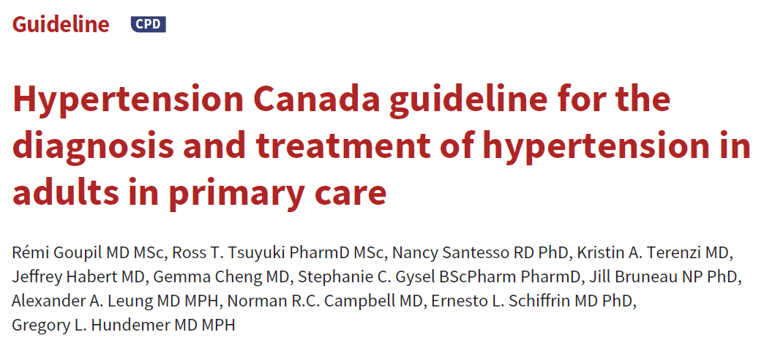
Goupil et al. CMAJ 2025

Slide 8
2025 Update
Simplified blood pressure targets
<130 for most patients
Goupil et al. CMAJ 2025

Slide 9
Diagnosis
Blood pressure assessment with a validated automated device and using a standardized method is recommended
Out-of-office BP assessment is recommended to confirm the diagnosis of hypertension or to detect white-coat hypertension and masked hypertension
Goupil et al. CMAJ 2025

Slide 10
Diagnosis
The definition of hypertension in adults is recommended as BP≥130/80 mm Hg when measured with a validated device under optimal conditions
  This is lower than prior guidelines, which was ≥ 135/85 HBPM Series, or ≥ 130/80 24 hr ABPM, or ≥ 140/90 in office (after multiple visits)
Meta-analysis of prospective study data has shown:
  Relative risk for major adverse cardiovascular events for people with BP ≥ 130–139/85–89 mm Hg is 1.5-2.0x higher than for people with BP < 120/80, and a risk substantially higher than for those with BP 120–129/80–84 mm Hg.
Goupil et al. CMAJ 2025
Guo et al Curr Hypertens 2013

Slide 11
Treatment
Healthy lifestyle changes are recommended for all adults with hypertension
  Less than 2g sodium/day. High potassium helpful too.
  Weight loss if obese
  Exercise
  Quitting smoking
  Minimize alcohol
Goupil et al. CMAJ 2025

Slide 12
Treatment
Pharmacotherapy initiation for hypertension is recommended for adults with BP ≥ 140/90 mm Hg and for adults with systolic BP 130-139 mm Hg at high cardiovascular disease risk
  So diagnose HTN if BP over 130, but start treatment as per above
  Different than prior guideline which recommended treating if over 160/100 (or 140/90 if increased CV risk, or 130/80 if diabetic)
Goupil et al. CMAJ 2025

Slide 13
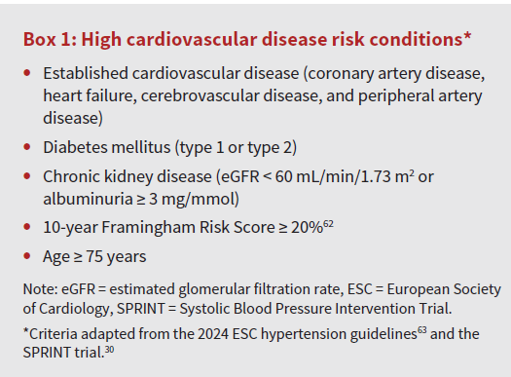
Goupil et al. CMAJ 2025

Slide 14
Treatment
Treatment, including healthy lifestyle changes with or without pharmacotherapy, is recommended for adults with hypertension to achieve a target SBP <130, provided the treatment is well tolerated
  Prior guidelines recommended target of <140/90 (for most)
Goupil et al. CMAJ 2025

Slide 15
Blood Pressure Target – Meta Analysis
Compared with a SBP target of ≥130, a SBP of <130 led to a 22% reduction in major adverse cardiovascular events and an 11% reduction in all-cause death.
Compared with SBP target <140, a target of <120 led to an 18% reduction in major adverse cardiovascular events and a possible reduction in all-cause death (HR 0.85, 95% CI 0.71-1.01).
Whelton et al. Hypertension 2024

Slide 16
Blood Pressure Target
SPRINT trial compared target <120 vs <140, had NNT of 61 for primary cardiovascular composite outcome (ACS, stroke, heart failure, or death from cardiovascular causes) and NNT of 90 for all-cause death
  Did have higher rate of hypotension, syncope, falls, electrolyte abnormalities, AKI
Wright et al. NEJM 2015

Slide 17
Blood Pressure Target
Guideline recommended target of <130 rather than <120 given
  Research quality BP measurements are generally 5-10 mm Hg lower than BP measurements in the routine clinical care setting
  Most participants in large RCTs targeting SBP<120 did not achieve this target
  Feedback from PCPs and patients
No specific diastolic target, given evidence that
  Adults with SBP <130 are at relatively low cardiovascular risk even when diastolic BP 70-90
Goupil et al. CMAJ 2025
Beddhu et al. Circulation 2018

Slide 18
Blood Pressure Target
Exceptions to SBP <130 include patient specific factors like
  Goals of care
  Frailty
  Fall Risk
  Orthostatic hypotension
  If limited by side-effects

Slide 19
Blood Pressure Target
Guidelines committee placed a high value on a simplified approach to hypertension management by adopting a single treatment target for all
While they recognize some people may benefit from a lower target, and others may tolerate only a higher target, they prioritized ease of implementation and did this in response to request for more pragmatic and streamlined guidance to hypertension management

Slide 20
Hypertension Management
For adults requiring pharmacotherapy:
Low-dose combination therapy (ideally as a single-pill combination) is recommended as initial treatment
Include drugs from 2 of 3 categories of ACE/ARB, thiazide or thiazide-like diuretics, and long acting dihydropyridine CCBs
About 70% of adults with HTN will require more than 1 class of medication to achieve BP control
  Projected to increase as targets are lower
Single-pill combinations achieve BP control in about 1/3 more patients than with standard monotherapy
Goupil et al. CMAJ 2025
Gu et al. Circulation 2012
Salam et al. Hypertension 2019

Slide 21
Hypertension Management
If BP remains above target despite 3 drug combination therapy consisting of ACE/ARB, thiazide or thiazide-like diuretic, and a long-acting dihydropyridine CCB at max tolerated doses:
  The addition of spironolactone is recommended
    Monitor electrolytes and renal function, careful with CKD or if already on ACE/ARB, as risk of hyperkalemia increased
    Also increased risk of gynecomastia
  Should also consider screening for hyperaldosteronism
Goupil et al. CMAJ 2025
Williams et al. Lancet 2015

Slide 22
Case
63 year old male
PMH: HTN
BP 153/85, HR 70.
What would be their target blood pressure?

Slide 23
Key Points
Diagnose hypertension if BP≥130/80 mm Hg
Treat to target SBP<130
For adults requiring pharmacotherapy, low-dose combination therapy (ideally as a single-pill combination) is recommended as initial treatment

Slide 24
References
DeGuire J et al. Blood pressure and hypertension. Health Rep 2019;30:14-21
Rabi D et al. Hypertension Canada’s 2020 Comprehensive Guidelines for the Prevention, Diagnosis, Risk Assessment, and Treatment of Hypertension in Adults and Children. Can J Cardiol 2020;36:596-624
Goupil R et al. Hypertension Canada guidelines for the diagnosis and treatment of hypertension in adults in primary care. CMAJ 2025; 197:E549-64
Guo X et al. Association between pre-hypertension and cardiovascular outcomes: a systematic review and meta-analysis of prospective studies. Curr Hypertens Rep 2013;15:703-16.
Whelton P et al. Optimal antihypertensive systolic blood pressure: a systematic review and meta-analysis. Hypertension 2024;81:2329-39.

Slide 25
References
SPRINT Research Group; Wright JT Jr, Williamson JD, Whelton PK, et al. A randomized trial of intensive versus standard blood-pressure control. N Engl J Med 2015;373:2103-16
Beddhu S et al.; SPRINT Research Group. Influence of baseline diastolic blood pressure on effects of intensive compared with standard blood pressure control. Circulation 2018;137:134-43
Gu Q al. Trends in antihypertensive medication use and blood pressure control among United States adults with hypertension: the National Health And Nutrition Examination Survey, 2001 to 2010. Circulation 2012;126:2105-14.
Williams et al. Spironolactone versus placebo, bisoprolol, and doxazosin to determine the optimal treatment for drug-resistant hypertension (PATHWAY-2): a randomized, double-blind, crossover trial. Lancet 2015;386: 2059-2068

Slide 26
Questions?

