Slide 1
Ehlers-Danlos: Diagnosis and Follow-Up
(a.k.a. what happens when you miss a meeting!)
Dr Noemie Gionet Landry, MD, FRCPC
NBIMU
April 24th, 2026

Slide 2
By the end of this session, participants will be able to:
Identify key clinical features of Ehlers–Danlos syndromes using practical bedside tools (e.g., Beighton score) and recognize red flags requiring specialty referral.
Apply a simplified diagnostic approach to differentiate EDS from common mimickers.
Implement an evidence-informed follow-up plan, including symptom-based management and appropriate long-term monitoring.

Slide 3
Disclosures
Consultations: Amgen, Pfizer, Sanofi Genzyme, Gilead, Novartis, Abbvie, Jenssen
Honorarium: BMS, Jenssen, Merck, UCB, Pfizer, Amgen

Slide 4
Connective tissue diseases
Auto-immune CTDs
Rheumatoid arthritis
Lupus
Systemic sclerosis
Sjogren
Myositis
MCTD
UCTD
Genetic connective
tissue disorders
Marfan syndrome
Ehlers-Danlos syndrome
Loeys-Dietz syndrome
…

Slide 5
Connective tissue diseases
Auto-immune CTDs
RA
Lupus
Systemic sclerosis
Sjogren
Myositis
MCTD
UCTD
Genetic connective
tissue disorders
Marfan syndrome
Ehlers-Danlos syndrome
Loeys-Dietz syndrome
…

Slide 6
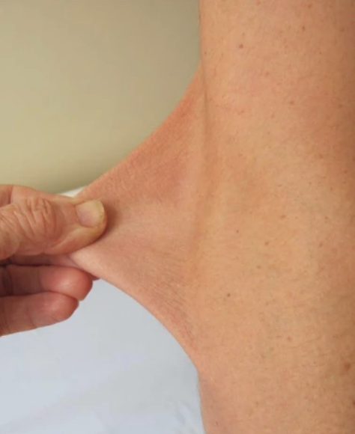
Ehlers-Danlos Syndrome
Heterogeneous group of heritable connective tissue disorders characterized by
  Joint hypermobility
  Skin hyperextensibility
  Tissue fragility
13 subtypes

Slide 7
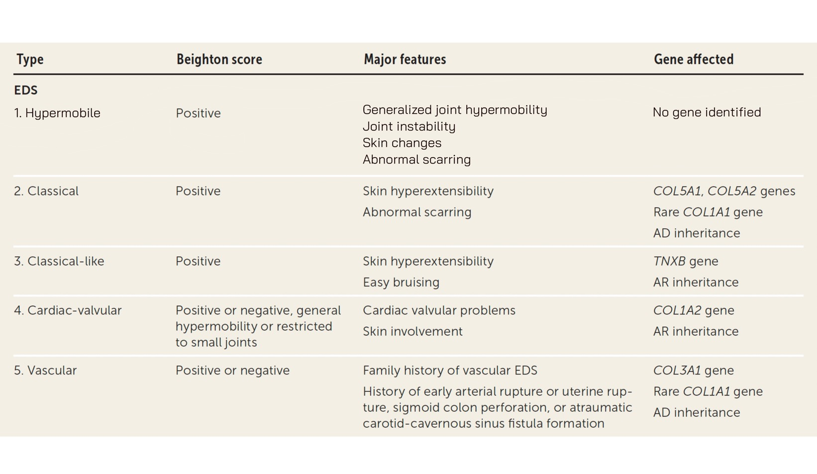
The 2017 international Ehlers–Danlos syndrome classification
Modified from Yew KS, Kamps-Schmitt KA, Borge R. Hypermobile Ehlers-Danlos Syndrome and Hypermobility Spectrum Disorders. Am Fam Physician. 2021 Apr 15;103(8):481-492. PMID: 33856167.
Notes:
Hypermobile EDS (hEDS): The most common form, though precise numbers are elusive due to underdiagnosis. Some studies suggest prevalence ranges from 1 in 3,100 to 1 in 10,000, with some research indicating it may be far more common.
Classical EDS (cEDS): Estimated at 1 in 20,000 to 1 in 40,000 individuals.
Vascular EDS (vEDS): A rare and severe form affecting approximately 1 in 100,000 to 200,000 people.
Other Subtypes: The remaining 10+ subtypes are considered extremely rare (ultra-rare), with many having only a few reported families or cases worldwide.

Slide 8
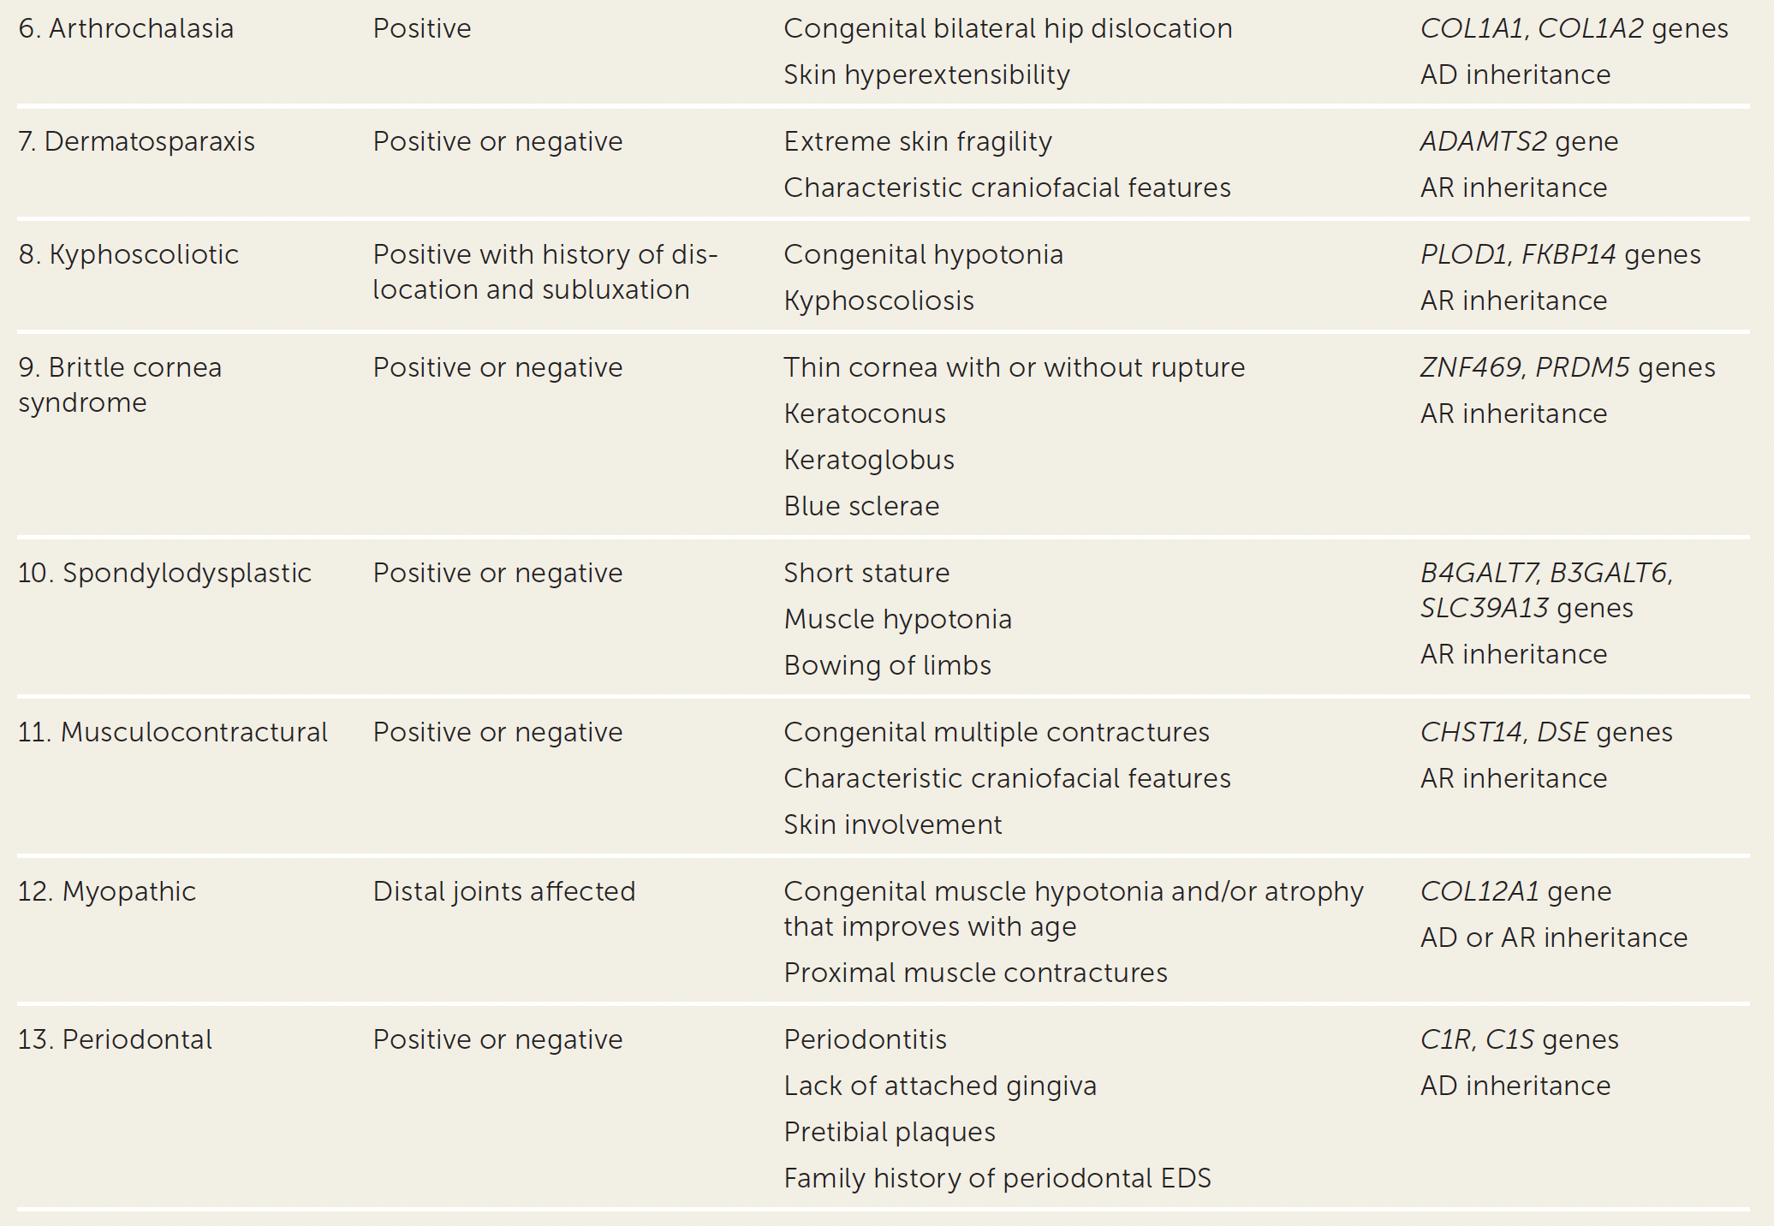

Slide 9
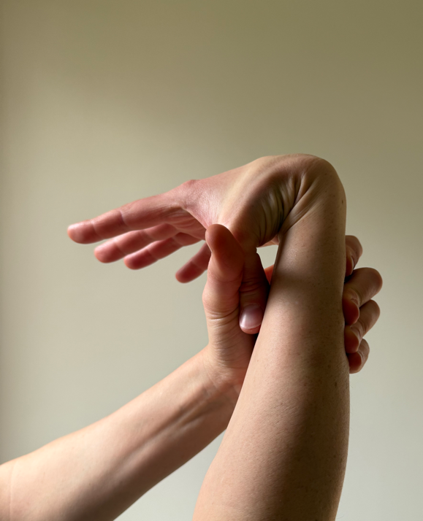
Clinical assessment of EDS
Diagnosis often suspected on the basis of joint hypermobility, abnormal wound healing, unexplained bruising and/or other signs of vascular/tissue fragility
However,
  Many features of EDS occur in the general population
  Some characteristics of EDS are found in other genetic conditions

Slide 10
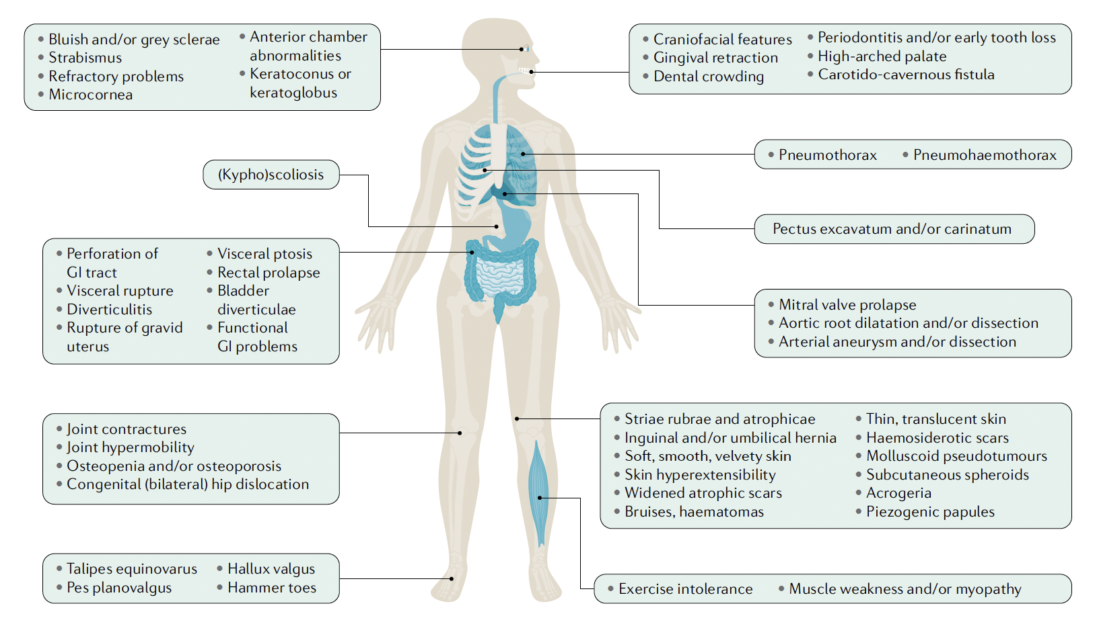
Malfait, F., Castori, M., Francomano, C.A. et al. The Ehlers–Danlos syndromes. Nat Rev Dis Primers 6, 64 (2020).

Slide 11
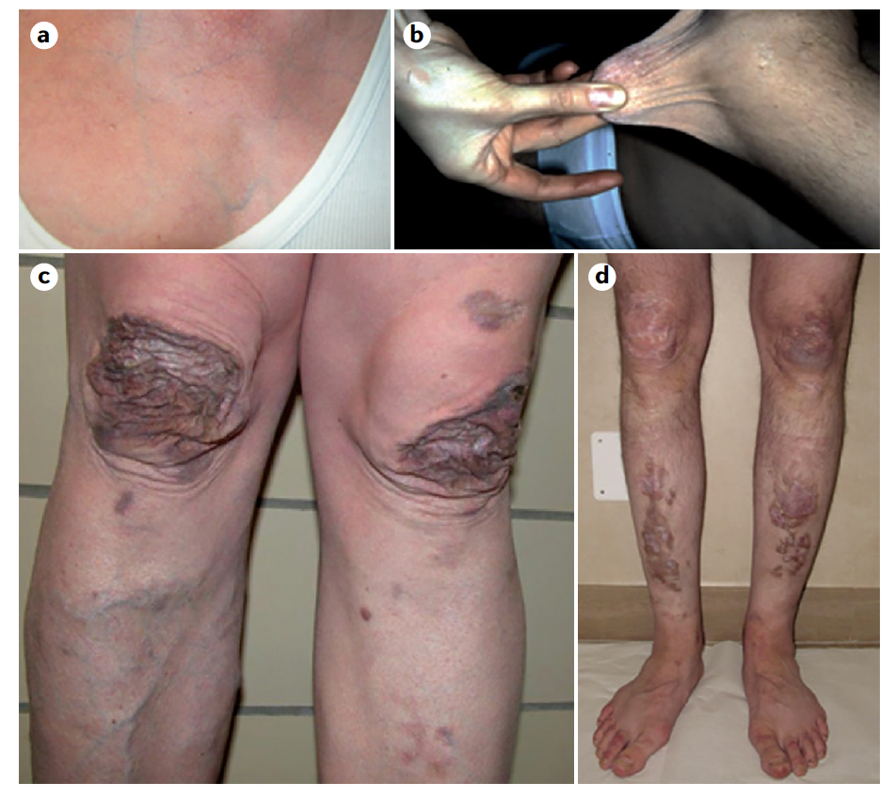
Notes:
Thin,
translucent skin. b | Skin hyperextensibility. c | Widened atrophic scarring. d | Haemosiderotic
scarring. Panels a and c adapted with permission from ref.226, Oxford University Press.

Slide 12
Hypermobile EDS
Remember, most hypermobile individuals do NOT have EDS!!
Exact prevalence unknown
  Anywhere between 1/500 and 1/5000
  Prevalence of generalized joint hypermobility is much higher!
Autosomal dominant transmission (incomplete penetrance)
No known genetic mutation to date

Slide 13
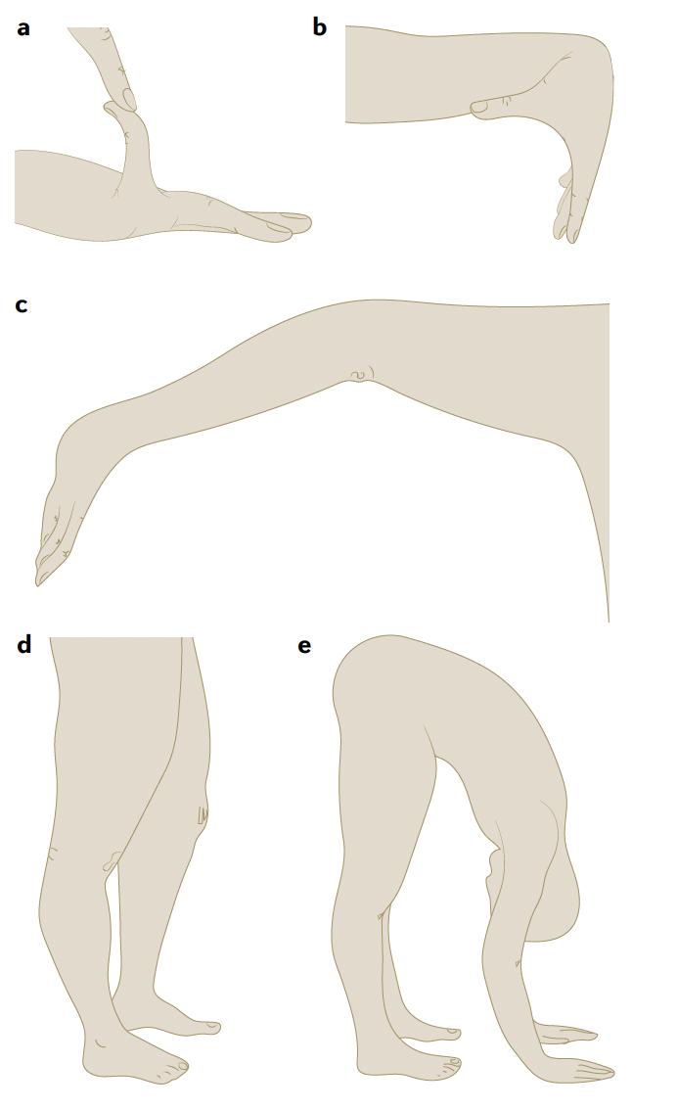
The Beighton scale
Passive dorsiflexion and hyperextension of the 5th MCP >90° (1 point/side)
Passive apposition of the thumb to the flexor aspect of the forearm (1 point/side)
Passive hyperextension of the elbow >10° (1 point/side)
Passive hyperextension of the knee >10° (1 point/side)
Active forward flexion of the trunk with the knees fully extended so that the palms of the hands rest flat on the floor scores (1 point)
Notes:
Passive dorsiflexion and hyperextension of the 5th MCP >90° with the palm of the hand and forearm resting on a flat surface with the elbow flexed at 90° (1 point/side)
Passive apposition of the thumb to the flexor aspect of the forearm with arms outstretched forward but hand pronated (1 point/side)
Passive hyperextension of the elbow >10° with the arms outstretched to the side of the body and hand supine (1 point/side)
Passive hyperextension of the knee >10° whilst standing upright with the knees locked in genu recurvatum (1 point/side)
Active forward flexion of the trunk with the knees fully extended so that the palms of the hands rest flat on the floor scores (1 point)

Slide 14
The Beighton scale
Total possible score = 9
Joint hypermobility defined by score ≥
6 for prepubertal children and adolescents
5 for pubertal men and women ≤50 years of age
4 for men and women >50 years of age

Slide 15
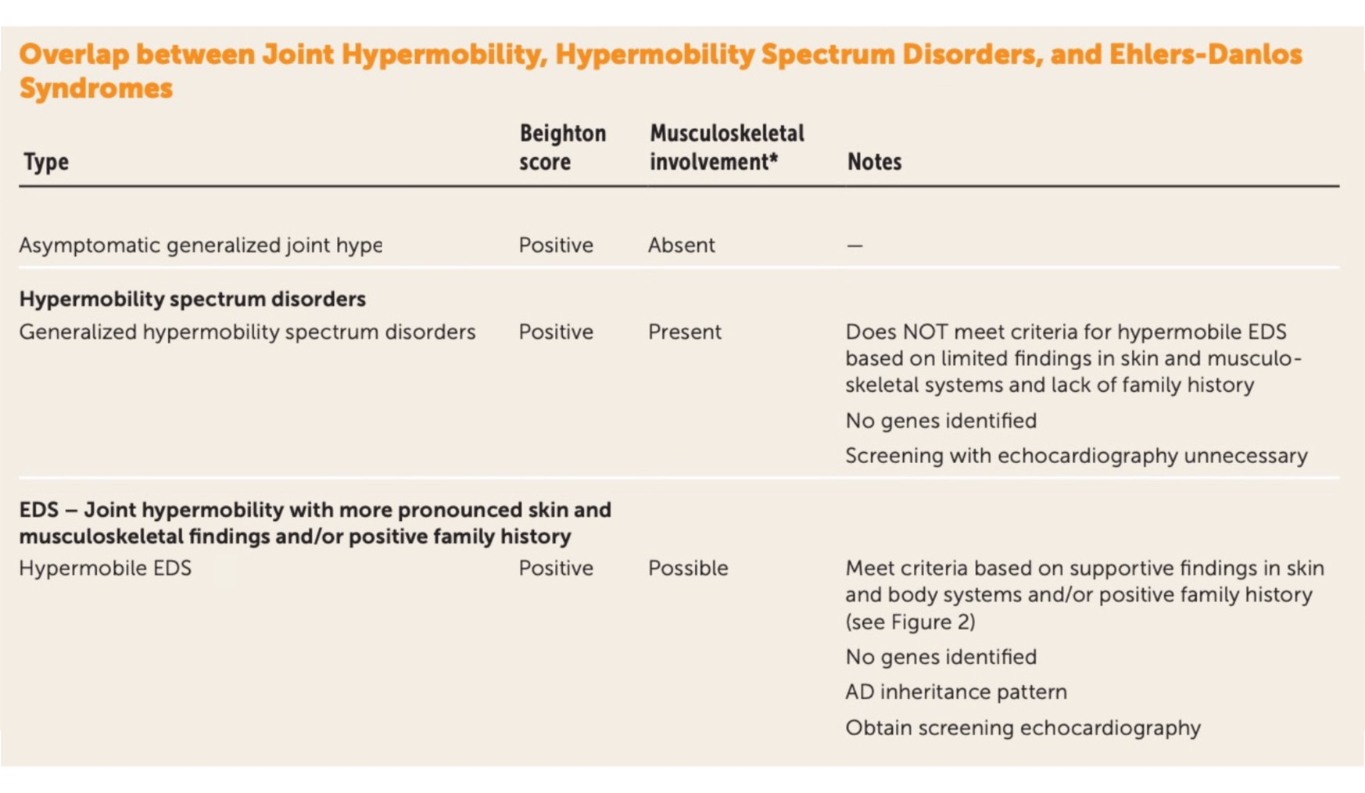
Yew KS, Kamps-Schmitt KA, Borge R. Hypermobile Ehlers-Danlos Syndrome and Hypermobility Spectrum Disorders. Am Fam Physician. 2021 Apr 15;103(8):481-492. PMID: 33856167.

Slide 16
Yew KS, Kamps-Schmitt KA, Borge R. Hypermobile Ehlers-Danlos Syndrome and Hypermobility Spectrum Disorders. Am Fam Physician. 2021 Apr 15;103(8):481-492. PMID: 33856167.

Slide 17
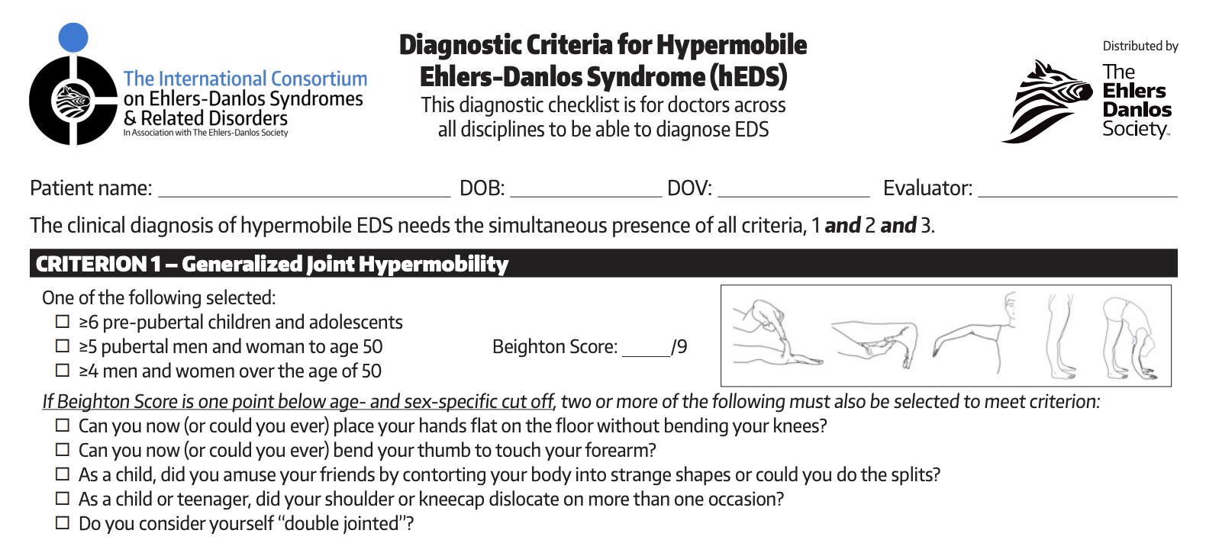

Slide 18
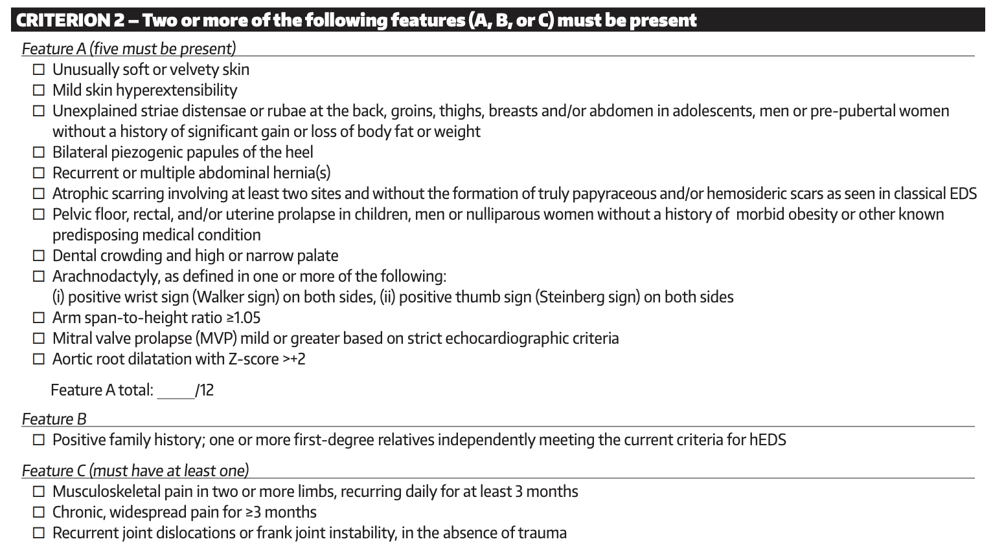

Slide 19
Soft or velvety skin
Mild skin hyperextensibility
Unexplained striae distensae or rubae Piezogenic papules of the heel
Recurrent or multiple abdominal hernia(s)
Mild atrophic scarring
Unexplained pelvic floor, rectal, and/or uterine prolapse
Dental crowding and high or narrow palate
Arachnodactyly
Arm span-to-height ratio ≥1.05
Mitral valve prolapse (MVP)
Aortic root dilatation
Positive family history
Chronic pain
Recurrent joint dislocations

Slide 20
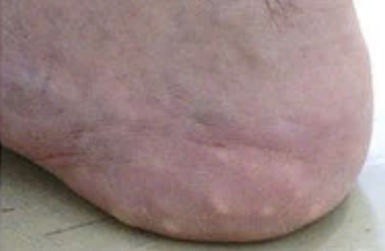
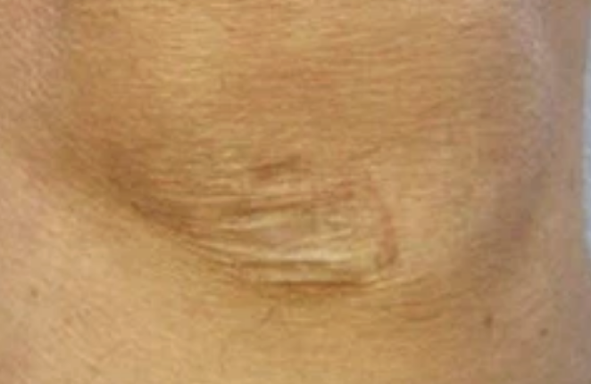
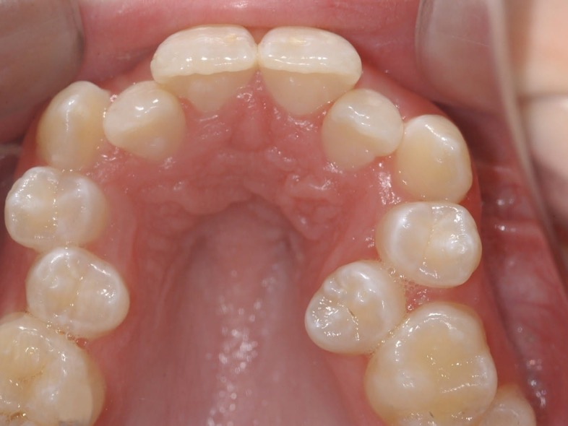
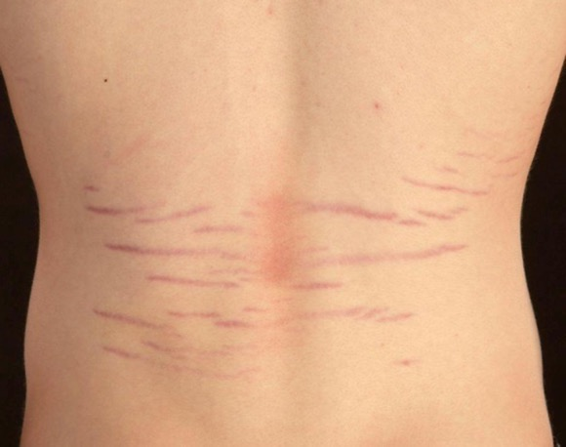
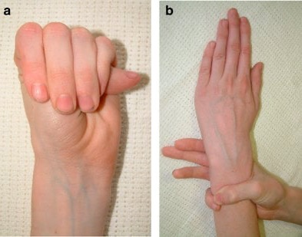

Slide 21
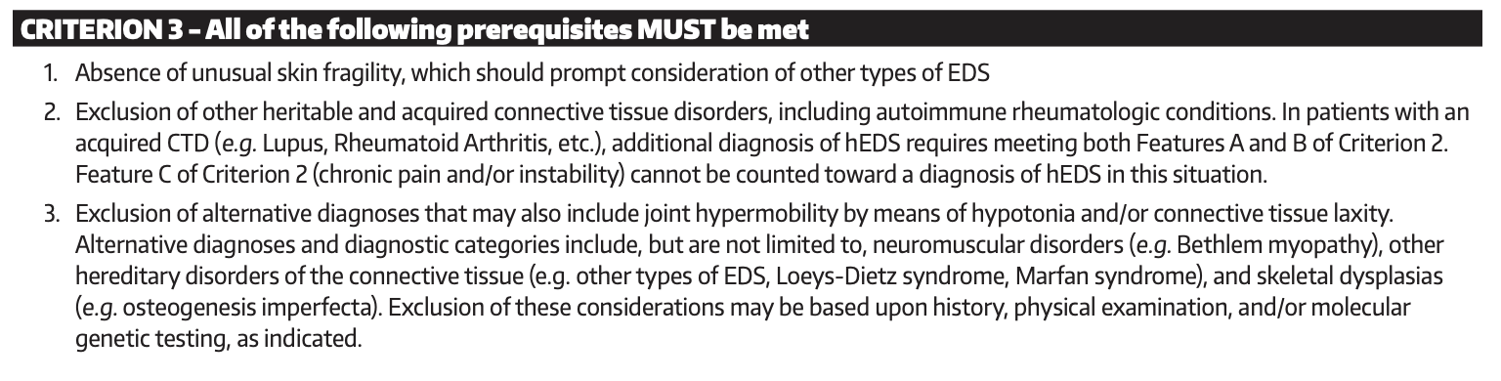

Slide 22
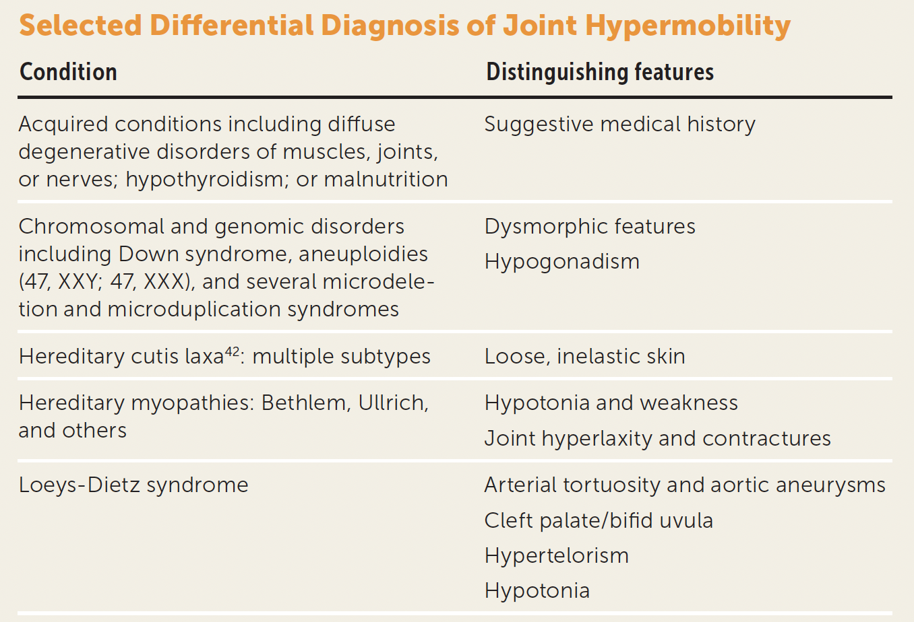
Yew KS, Kamps-Schmitt KA, Borge R. Hypermobile Ehlers-Danlos Syndrome and Hypermobility Spectrum Disorders. Am Fam Physician. 2021 Apr 15;103(8):481-492. PMID: 33856167.

Slide 23
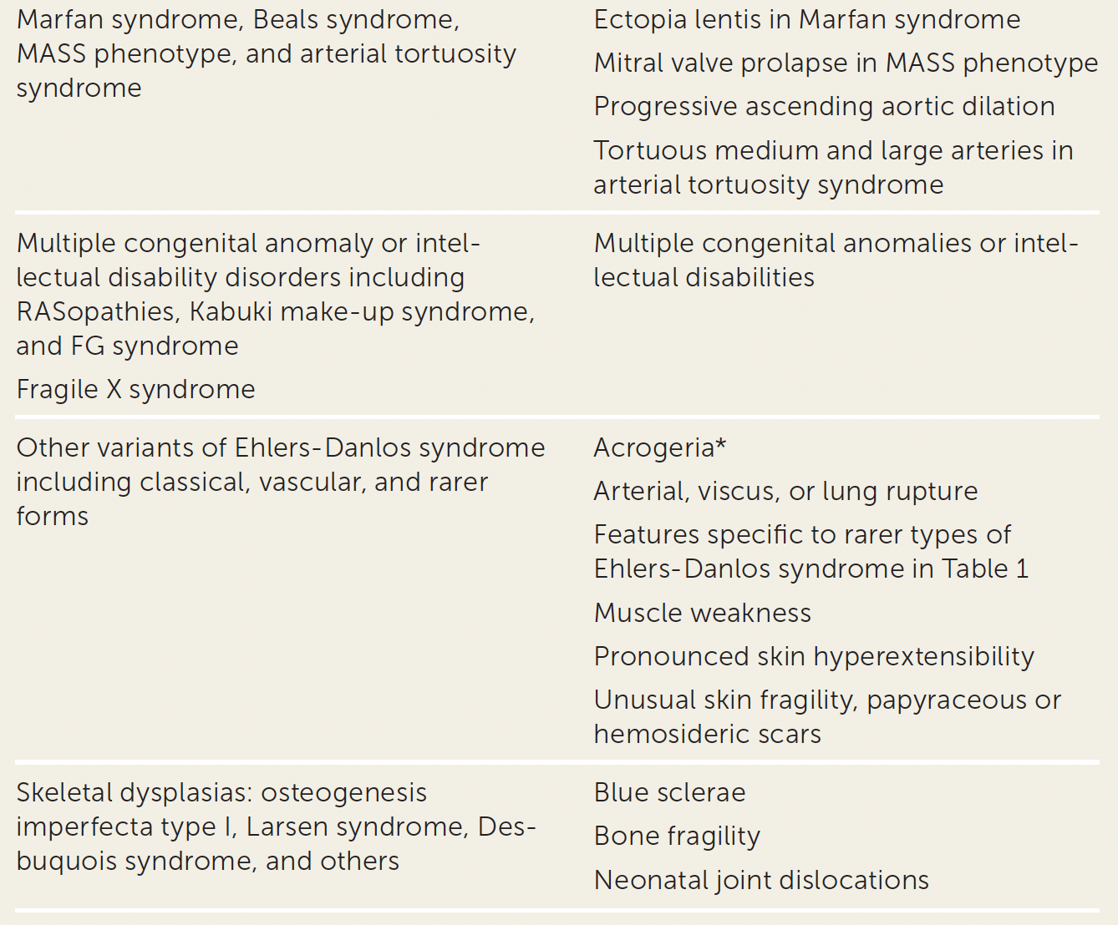

Slide 24
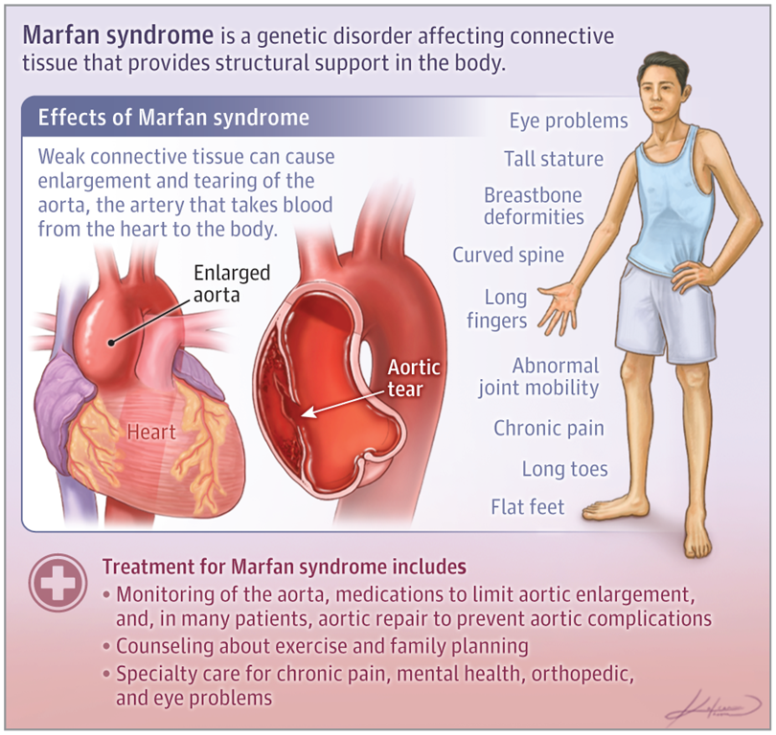


Slide 25
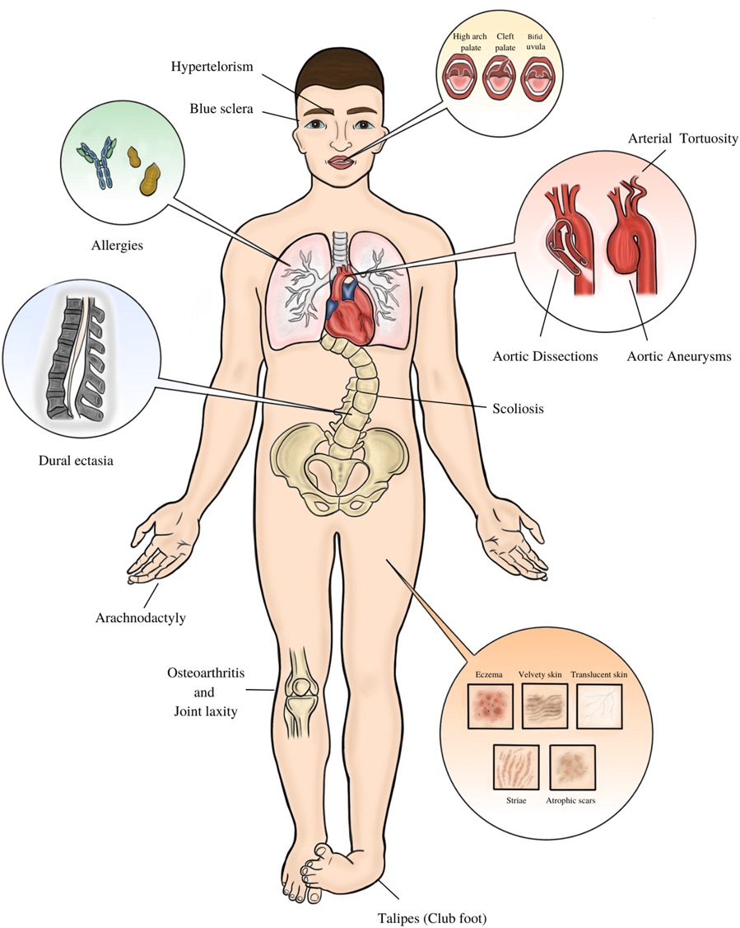
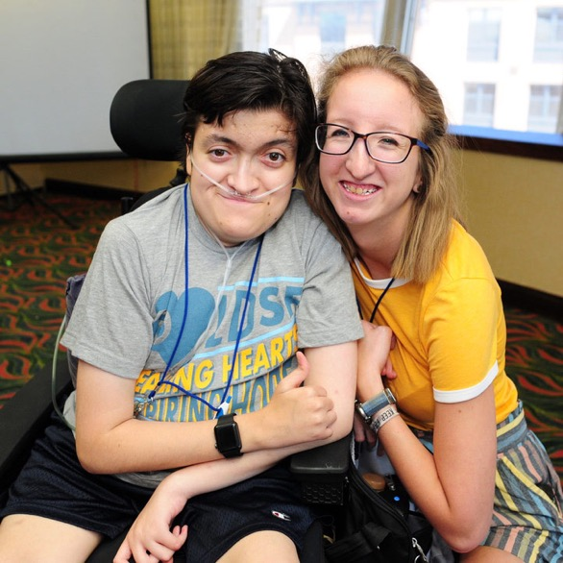
Loeys-Dietz Syndrome
Notes:
first described in 2005.
craniofacial features that include hypertelorism (widely spaced eyes) and a bifid or broad uvula.
smaller percentage of individuals, craniosynostosis (premature fusion of the skull bones), cleft palate and/or club foot are noted.
Almost 100% of patients show some type of abnormal skin findings including translucent skin, soft or velvety skin, easy bleeding, easy bruising, recurrent hernias, and scarring problems.
On radiological imaging, many individuals show tortuous vessels,

Slide 26
Management of hEDS
Patient education
Physical therapy
  Strengthening exercises, proprioceptive exercises, and joint protection
Occupational therapy
Psychological support
Self-management

Slide 27

Indications for genetic referral
TTE showing aortic dilation, mitral valve prolapse or bicuspid aortic valve
Thoracic or cerebral aneurysm, history of vascular dissection or hollow organ rupture
Presence of a positive family history of a first-degree relative ONLY with thoracic or cerebral aneurysm, vascular dissection or hollow organ rupture
Close relative of the patient diagnosed with a subtype of EDS other than hypermobile EDS
Patient with one of the following:
  Translucent skin
  Atrophic scars
  Abnormally spaced eyes (hypertelorism)
  A bifid uvula
  Pneumothorax
  Non-traumatic tendon ruptures

Slide 28
Ressources for HCP and patients
Medical Resources:
Adult Management: “Hypermobile Ehlers-Danlos Syndrome”, Genereviews, Levy H https://www.ncbi.nlm.nih.gov/books/NBK1279/
Adult Physiotherapy: https://www.ehlers-danlos.org/information/physical-therapy-for-hypermobility/
Muldowney protocol: https://www.muldowneypt.com/ehlers-danlos-syndrome-information/

Slide 29
Ressources for HCP and patients
Websites and Support Groups for EDS:
(Local) Atlantic Ehlers-Danlos Support: https://www.atlanticedssociety.ca
Ehlers-Danlos Society: https://www.ehlers-danlos.com/
Ehlers-Danlos Support (UK): https://www.ehlers-danlos.org/
Hypermobility Syndromes Association: http://hypermobility.org/
Genetics Research: A large donation has enabled a research study to be launched buy EDS International to try to identify the genetics basis for hEDS. You can register your interest and find further details at: https://www.ehlers-danlos.com/eds-global-registry/

Slide 30


Slide 31
References
Yew KS, Kamps-Schmitt KA, Borge R. Hypermobile Ehlers-Danlos Syndrome and Hypermobility Spectrum Disorders. Am Fam Physician. 2021 Apr 15;103(8):481-492. PMID: 33856167.
Malfait, F., Castori, M., Francomano, C.A. et al. The Ehlers–Danlos syndromes. Nat Rev Dis Primers 6, 64 (2020).
https://www.ehlers-danlos.com/heds-diagnostic-checklist/

Slide 32
Key point #1
e.g. Ehlers-Danlos
e.g. Lupus
Even though genetic CTDs and auto-immune CTDs are both called connective tissue diseases, they have NOTHING to do with each other.
That means…

Slide 33
Key point #1
Even though genetic CTDs and auto-immune CTDs are both called connective tissue diseases, they have NOTHING to do with each other.
That means… do NOT order an ANA if you suspect Ehlers-Danlos!

Slide 34
Key point #2
Hypermobile EDS is by far the most common subtype of EDS (80-90%)
The exact percentage is estimated, because:
There is no confirmatory genetic test
Diagnosis is clinical

Slide 35
Key point #3
The key clinical priority is to exclude rarer EDS subtypes (e.g., vascular EDS) and other genetic connective tissue disorders (e.g., Marfan, Loeys-Dietz), which can have life- or organ-threatening complications.
In contrast, hEDS is not life-threatening but can cause significant chronic pain and disability.

Slide 36
Key point #4
Chronic pain and fatigue are extremely common with EDS (especially hEDS)—and often multifactorial
Pain is not just “joint instability”
Associated central sensitization (fibromyalgia) is very common

Slide 37
Key point #5
Physiotherapy is the cornerstone of management of hypermobility and pain in EDS
Focus on:
  Stabilization > flexibility
  Proprioception training
  Gradual strengthening
Avoid:
  Overstretching (often worsens symptoms)

