Slide 1
Hyperaldosteronism screening and diagnosis
Michael Pelkey MD, FRCPC

Slide 2

Disclosure
Michael Pelkey
Relationship with financial sponsors
  Direct financial relationship, including honoraria: Have done CME for Abbott for diabetes continuous sensing
  Membership on Advisory boards or Speakers’ bureaus: None
  Patent for drugs or devices: None
  Other financial relationships or investments: None

Slide 3
Mitigation of Potential Bias
Explain how potential sources of bias will be identified
If none exist, state : Not applicable

Slide 4
Key Reference
Primary Aldosteronism: An Endocrine Society Clinical Practice Guideline
(JCEM July 2025 - Journal of Clinical Endocrinology and Metabolism Vol 110, P. 2453-2495)

Slide 5
Objectives for Primary Hyperaldosteronism (PA)
Brief review of the renin / aldosterone system (RAS)
Who and how to screen for hyperaldosteronism
What constitutes a positive test
When to use confirmatory testing
How to interpret the aldo / renin in context of BP meds

Slide 6
Why is PA important?
It is the most common secondary cause of hypertension - making up 5-14% of those with hypertension. ^{1,2}
It has actions outside the classic receptor that leads to higher rates of renal and cardiac inflammation and fibrosis. ^{3,4}
As such, there are higher rates of renal injury, stroke, atrial fibrillation, coronary artery disease, and heart failure regardless of BP. ^{5,6}
However, there are low rates of screening (<5%) even in those with high risk features such as hypokalemia. ^{7,8,9}

Slide 7
Why is testing rare?
It is not thought of - previously lists of criteria of when to do it
People are not sure what to do with current anti-hypertensives
How to interpret grey zone tests
Doing confirmatory testing
Doing adrenal vein sampling

Slide 8
How to screen
Aldosterone and renin levels - taken appropriately. Include potassium.
The key is the renin level - if it is suppressed and aldosterone is inappropriate - then likely dealing with PA
The ratio is not the key, but it is helpful. There are several other reasons to have a low renin, and generally the aldo is also low. A higher ratio leans to PA being the cause

Slide 9
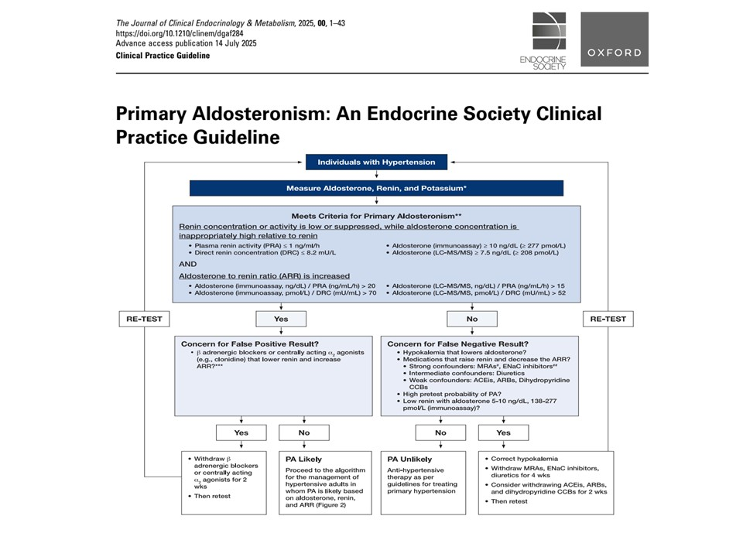

Slide 10
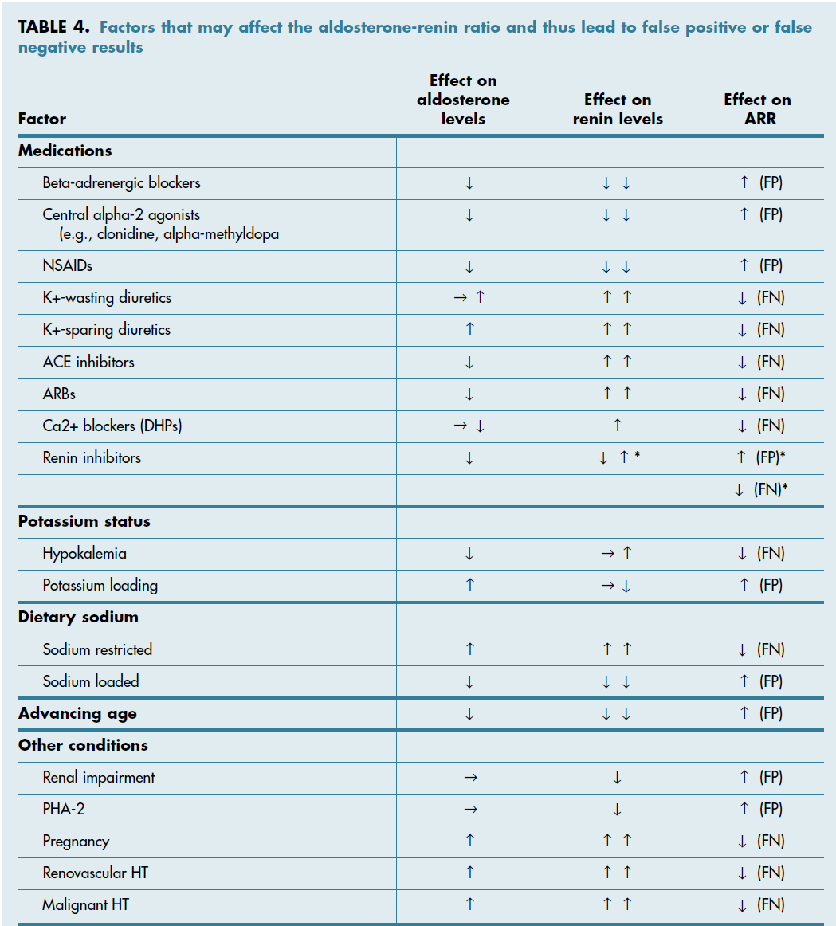

Slide 11
Meds that can be used
Alpha 1 blockers (prazosin, doxazosin, etc)
Hydralazine
Verapamil

Slide 12
What about confirmatory testing?
In previous versions of guidelines - diagnosis was a 2 step process. Once a positive ratio, then aldosterone suppression testing was done
It is not clear now that these tests correlate at all to outcomes, or even clarify the diagnosis (not clear it reduces false positives or improves the pickup rate)
The panel could find no RCT that looked at any of these tests

Slide 13
Tests used
Oral salt load
Saline suppression
Captopril challenge
Fludrocortisone suppression

Slide 14
Lateralization Likelihood
Low:
Aldosterone in the lower half of normal
Potassium normal
High
Renin suppressed
Aldosterone above normal range
Hypokalemia

Slide 15
Summary
Screen everyone now instead of trying to remember the list
Do not stop meds to test - just keep in mind what the meds will do when interpreting
Confirmatory testing is not a need in most cases

Slide 16
5 Key points
Hyperaldosteronism has morbidity and mortality risks above and beyond hypertension alone
New guidelines suggest a measurement of aldodosterone and renin in ALL those diagnosed with hyperaldosteronism
Aldo / renin ratio is still considered, but an undetectable renin is a key screening finding, not just the ratio
Aldo / renin can be measured while on medications that interfere with their values, as long as it is interpreted knowing what they are on
We do not need to do confirmatory testing in all (maybe not most?) patients

Slide 17
References
Imaging and charts:
Phlebotomycareertraining.com. The renin - aldosterone system: A step by step guide.
Anna S. Diversity: When Everyone is different, we all belong. Linked In
Endo Society guidelines - this iteration (2025) and previous (2012)
Yang YH, Chang YV et al. Strategies for Subtyping PA. J of Formoson Med Association 123 (2024) 5144-5124.
Question. Wikipedia

Slide 18
References
Monticone S, Burello J, Tizzani D, et al. Prevalence and clinical manifestations of primary aldosteronism encountered in primary care practice. J Am Coll Cardiol. 2017;69(14):1811-1820
Libianto R, Ruddell GM, Stowasser M, et al. Detecting primary aldosteronism in Australian primary care: a prospective study. Med J Aust. 2022;216(8):408-412.
John JG, Welch AK, et al. Aldosterone: Renal action and physiologic effects. Compr Physiol. 2023 Mar 30, 12(2):4409-4491. doi:10.1002/cphy.c190043.
Cannavo A, Benovenga L. Aldosterone and mineralocorticoid receptor system in cardiovascular physiology and pathophysiology. Oxid Med Cell Longev. Setp 19, 2018:1204598. doi:10.1155/2018/1204598.
Monticone S, Sconfienza E, D’Ascenzo F, et al. Renal Damage in primary aldosteronism: as systematic review and meta-analysis. J Hypertens. 2020;38(1):3-12.
Monticone S, D’Ascenzo F, Moretti C, et al. Cardiovascular events and target organ damage in primary aldosteronism compared with essential hypertension: a systematic review and meta-analysis. Lancet Diabetes Endocrinol. 2018;6(1):41-50
Mulatero P, Monticone S, Burrello J, et al. Guidelines for primary aldosteronism: uptake by primary care physicians in Europe. J Hypertens. 2016;34(11):2253-2257.
Cohen JB, Cohen DL, Herman DS, et al. Testing for primary aldosteronism and mineralocorticoid receptor antagonist use among US vets: a retrospective cohort study, Ann Intern Med. 2021;174(3):289-297.
Hundemer GI, Imsirovic H, Vaidya A, et al. Screening rates for primary aldosteronism among individuals with hypertension with hypokalemia: a population based retrospective cohort study. Hypertension. 2022;79(1):178-186.

